Slide 1
Healthy Cleanse
IBS, Candida, Crohn’s, Fatigue, constantly tired will all be helped by a Colon Cleanse

Slide 2
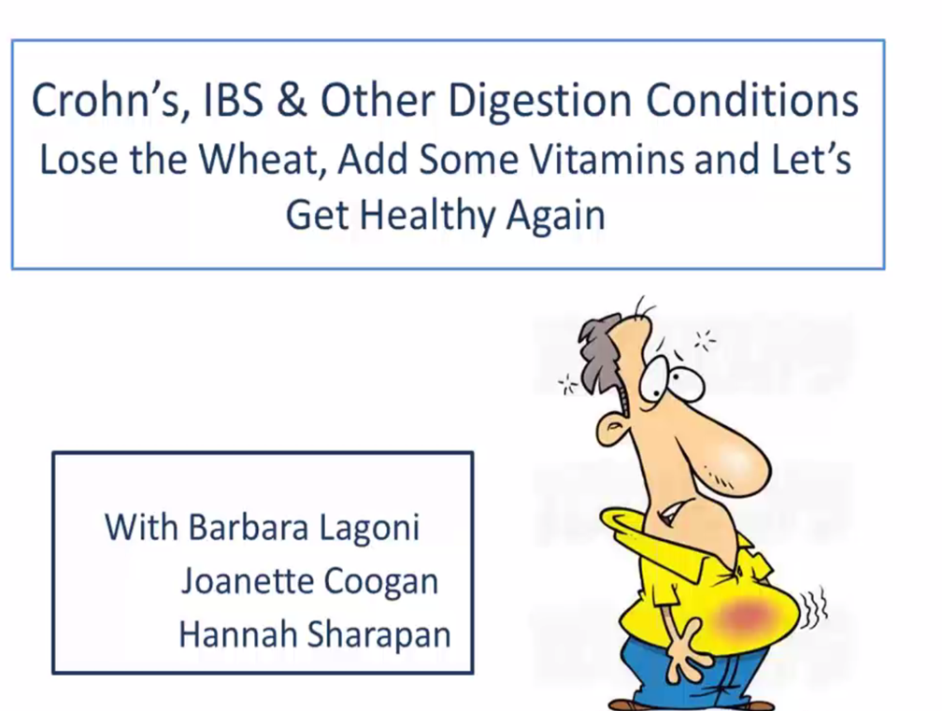

Slide 3

Catherine’s Story
Born 6 weeks premature
7 isolated cases of seizures
Suppose to be in the bottom 10% of head, hand and feet size
Went to John Hopkins to be part of a National Rett Study
Found out that we truly have a Shaklee miracle with Catherine.
************
On no medications
No seizures in the past 10 years.
In the normal growth range in size
As a girl with Rett Syndrome, she is suppose to be in a wheel chair- she walks!
Her incredible physical ability, thanks to Shaklee, is Priceless!

Slide 4
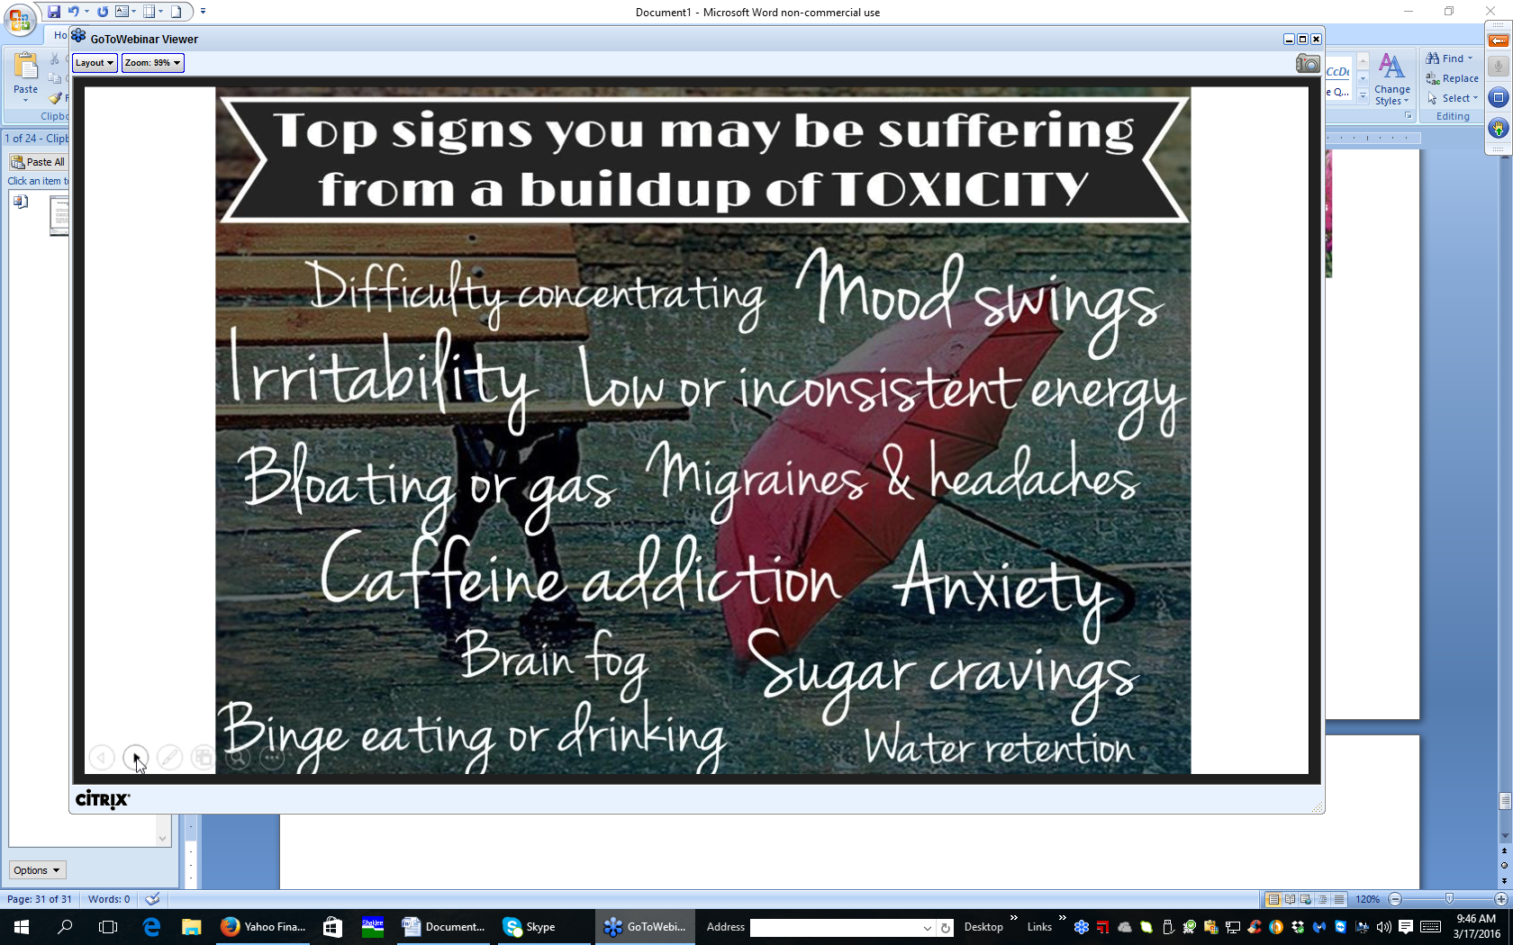

Slide 5
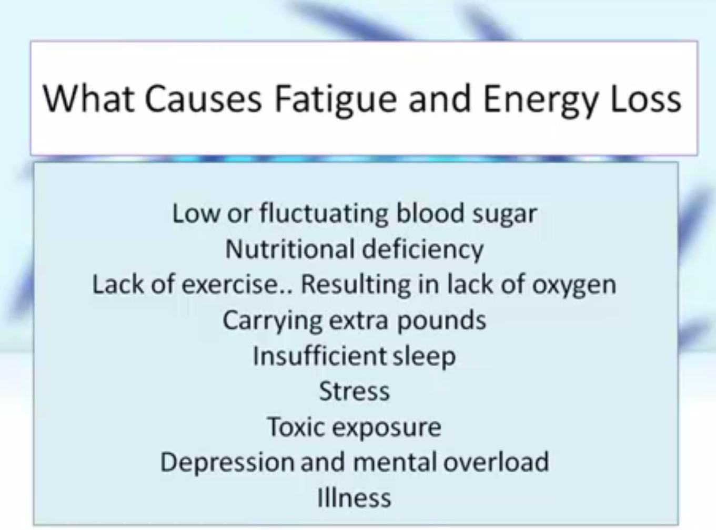

Slide 6
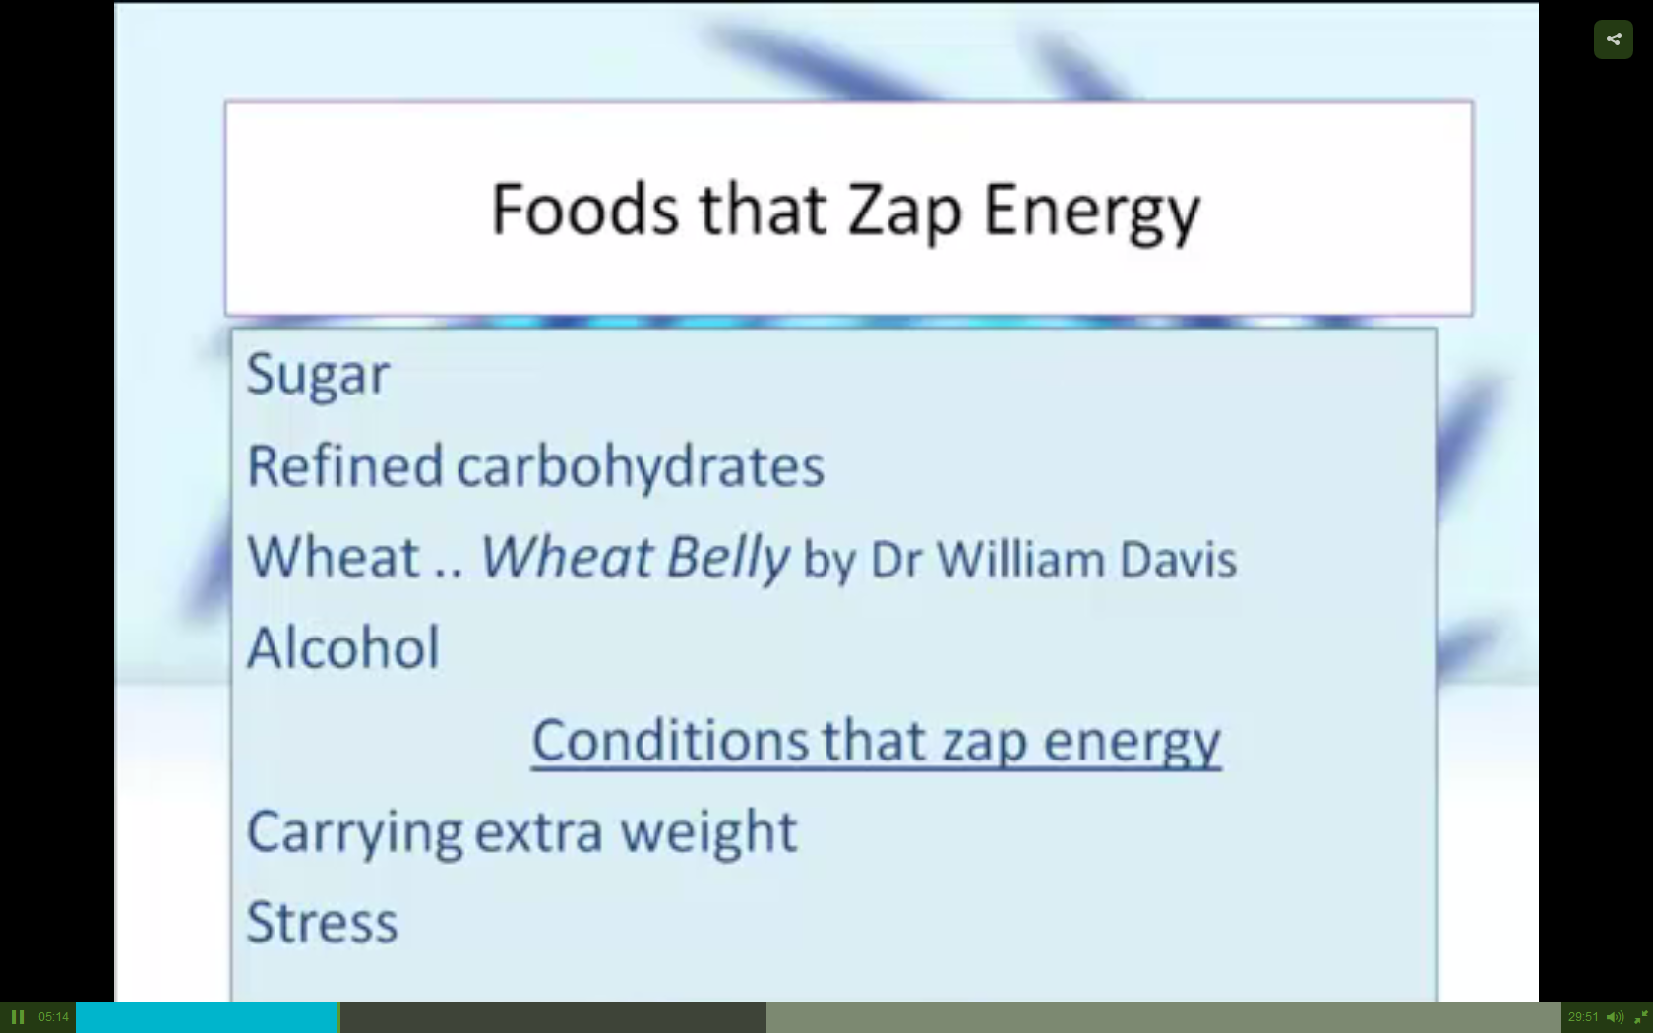

Slide 7
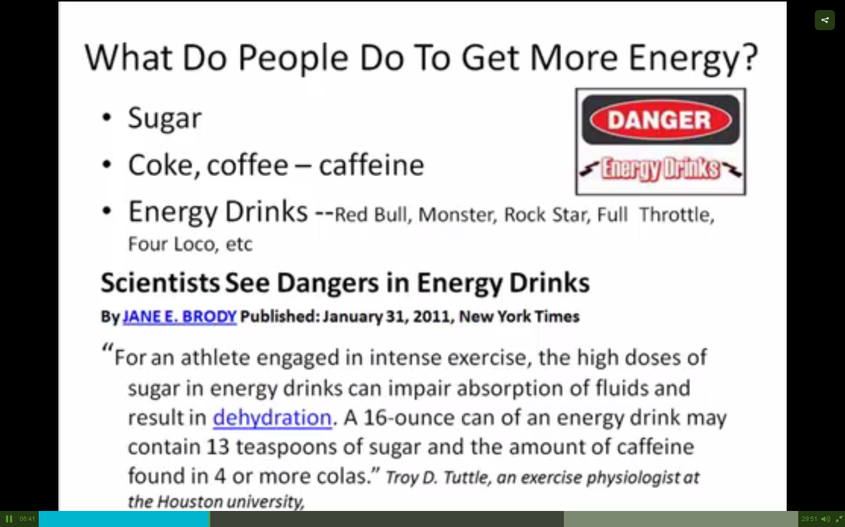

Slide 8
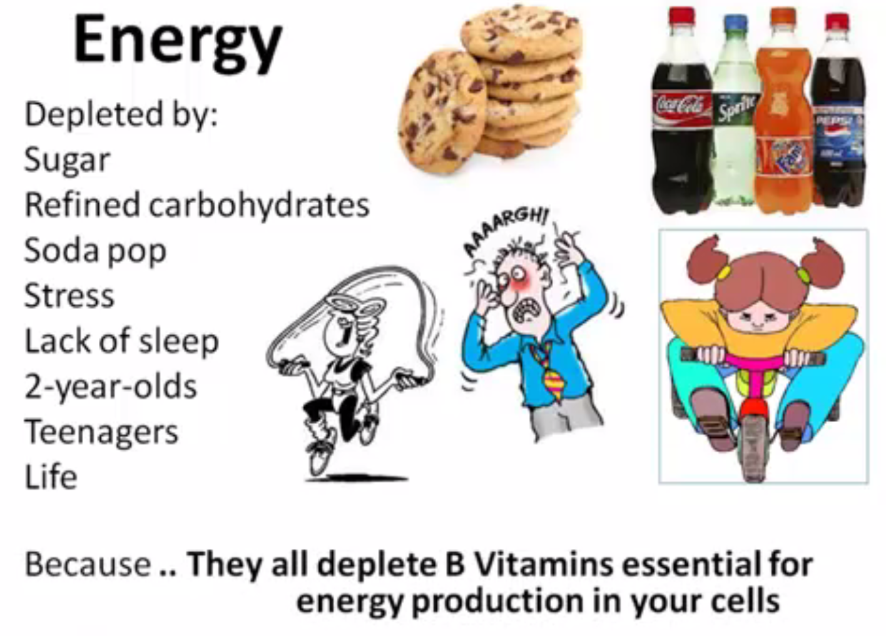

Slide 9
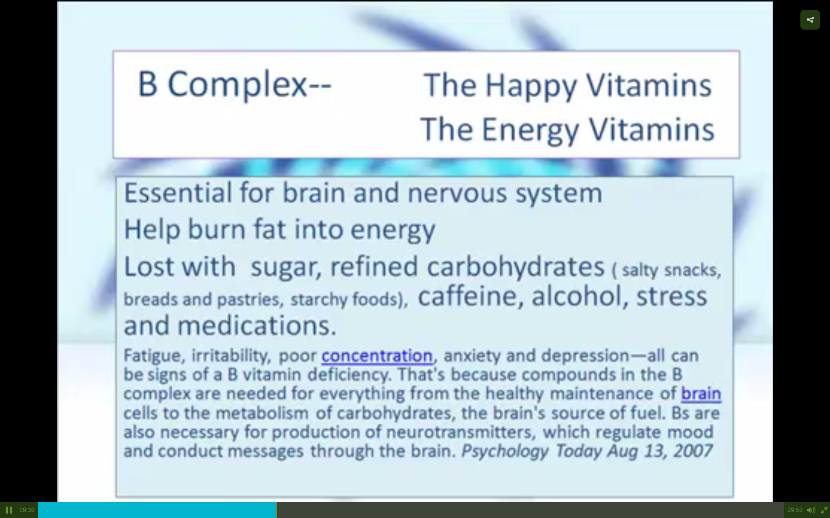

Slide 10
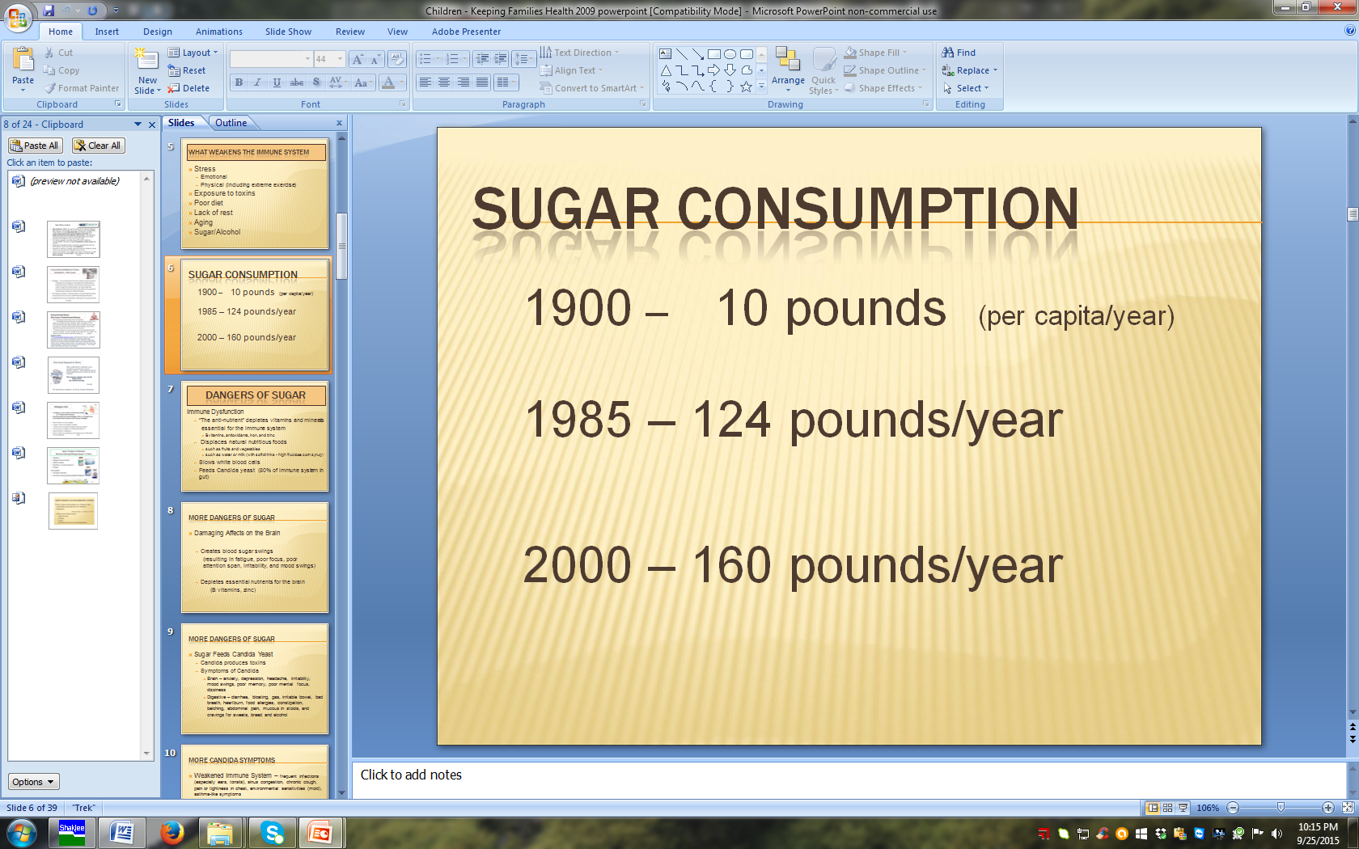

Slide 11
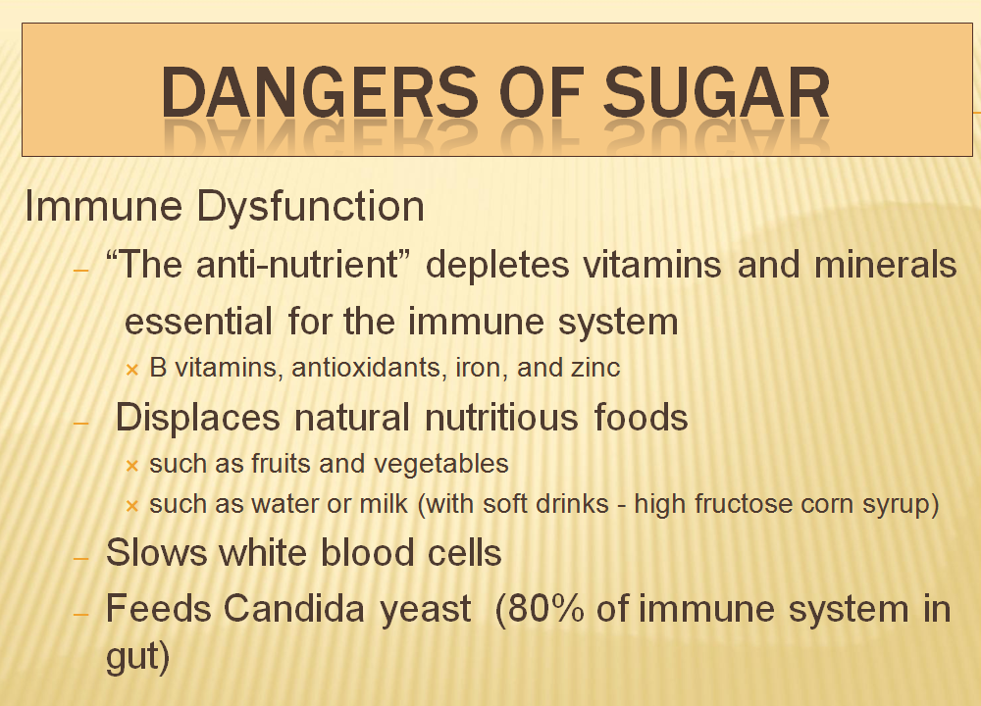

Slide 12
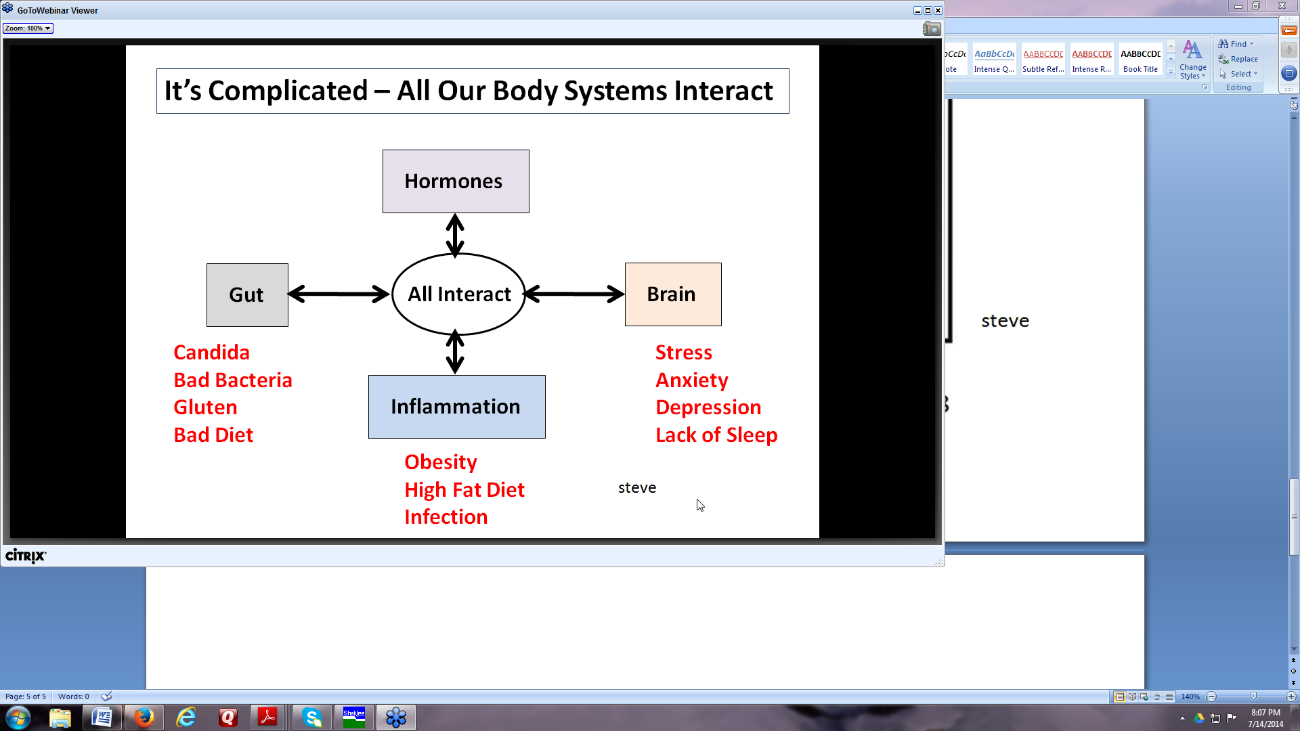

Slide 13
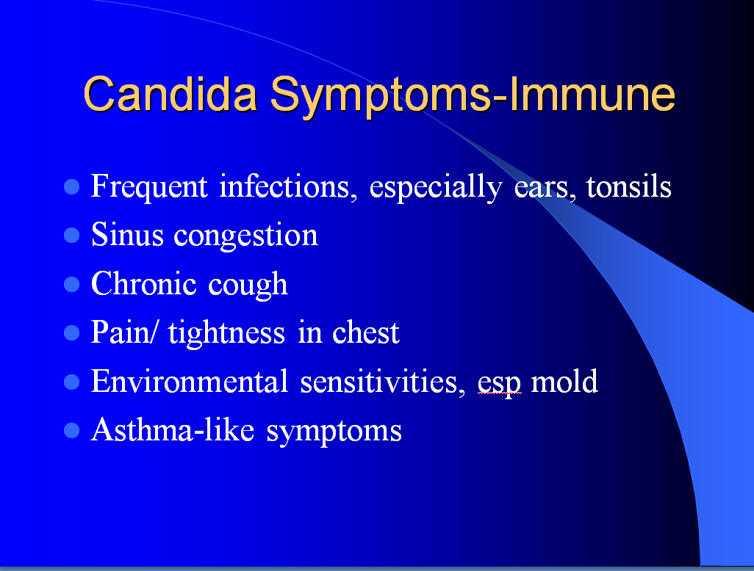

Slide 14
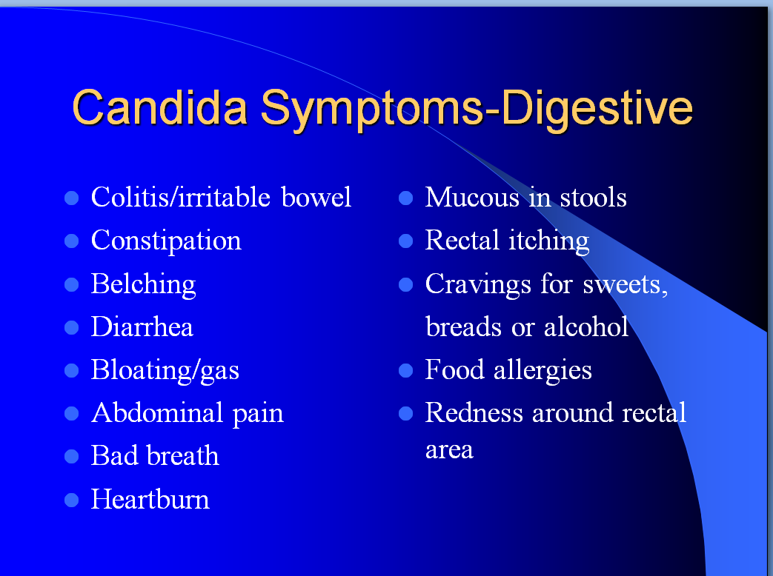

Slide 15
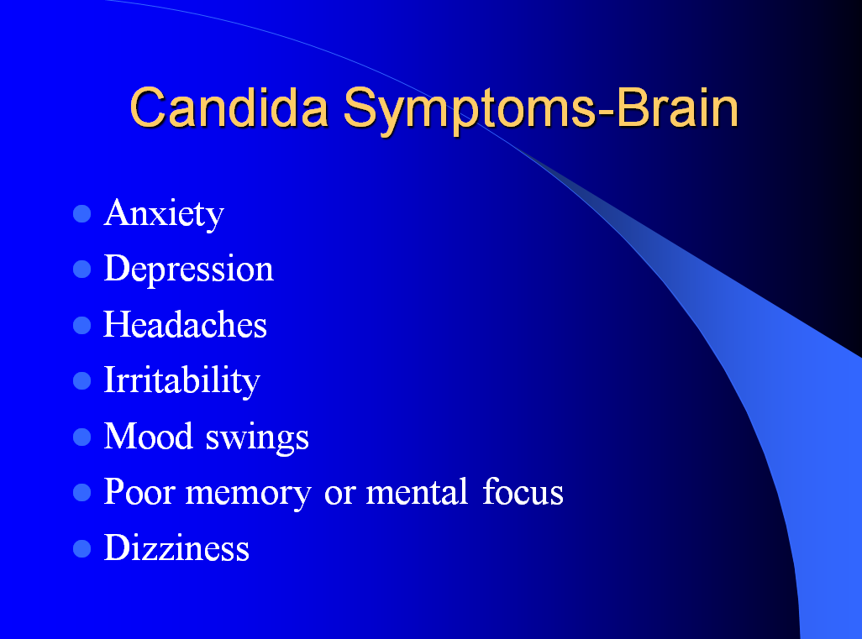

Slide 16
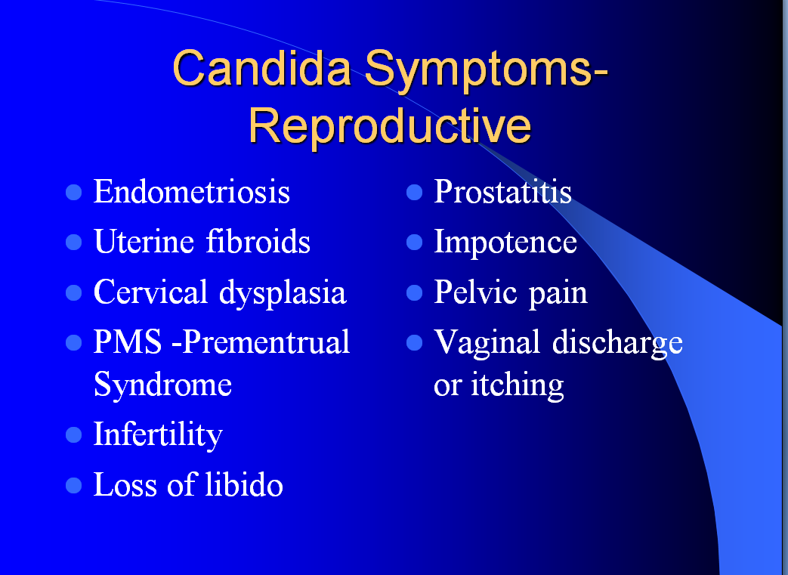

Slide 17
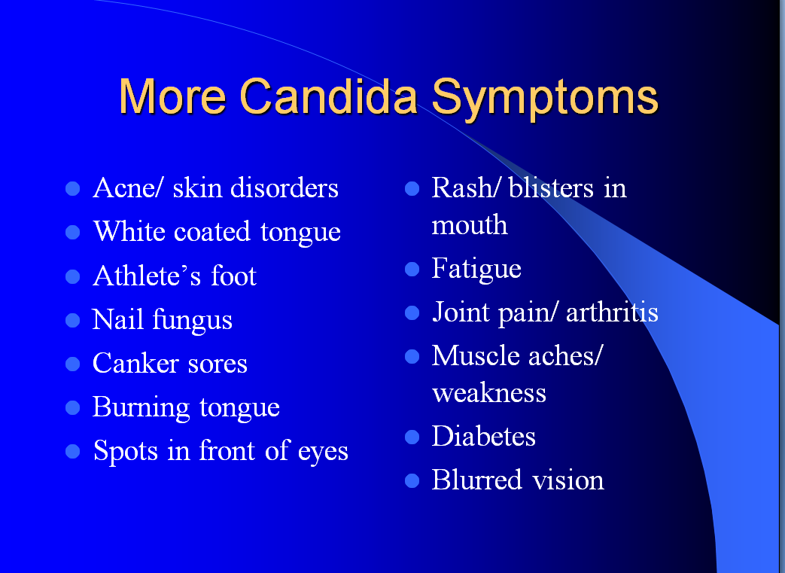

Slide 18
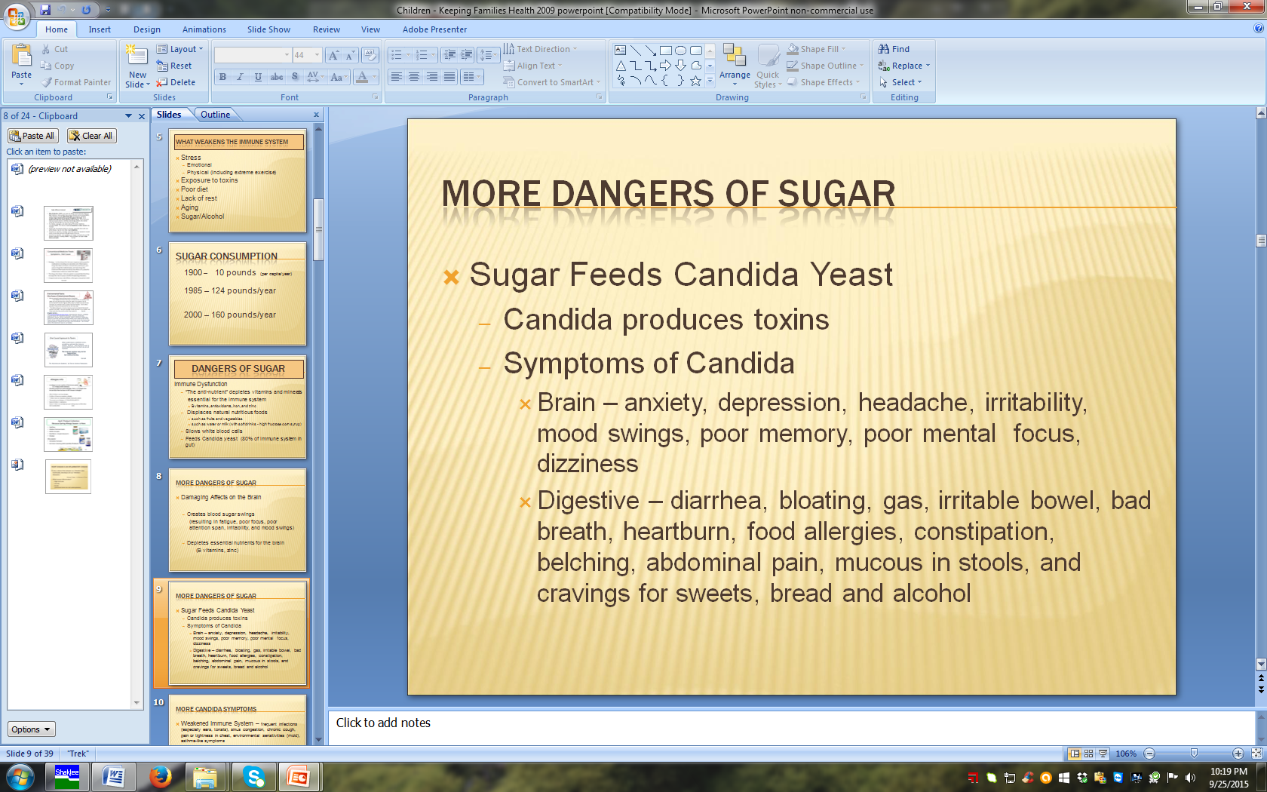

Slide 19
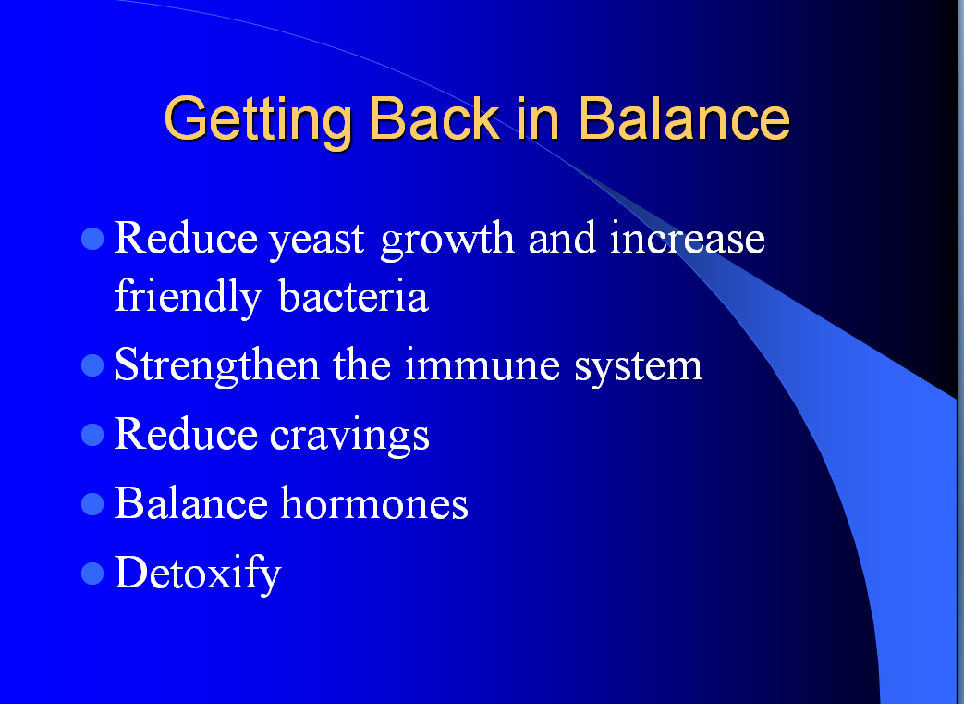

Slide 20
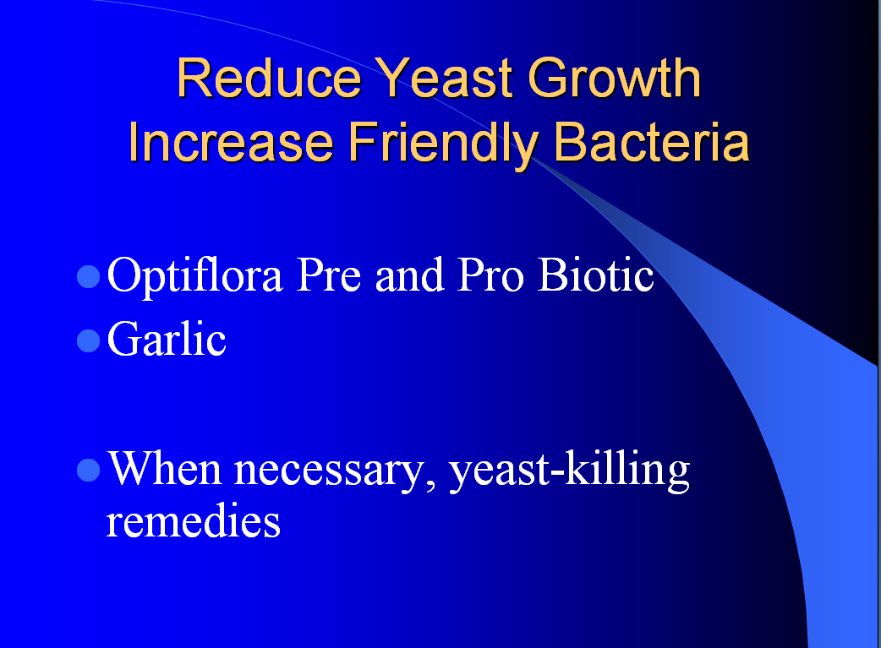

Slide 21
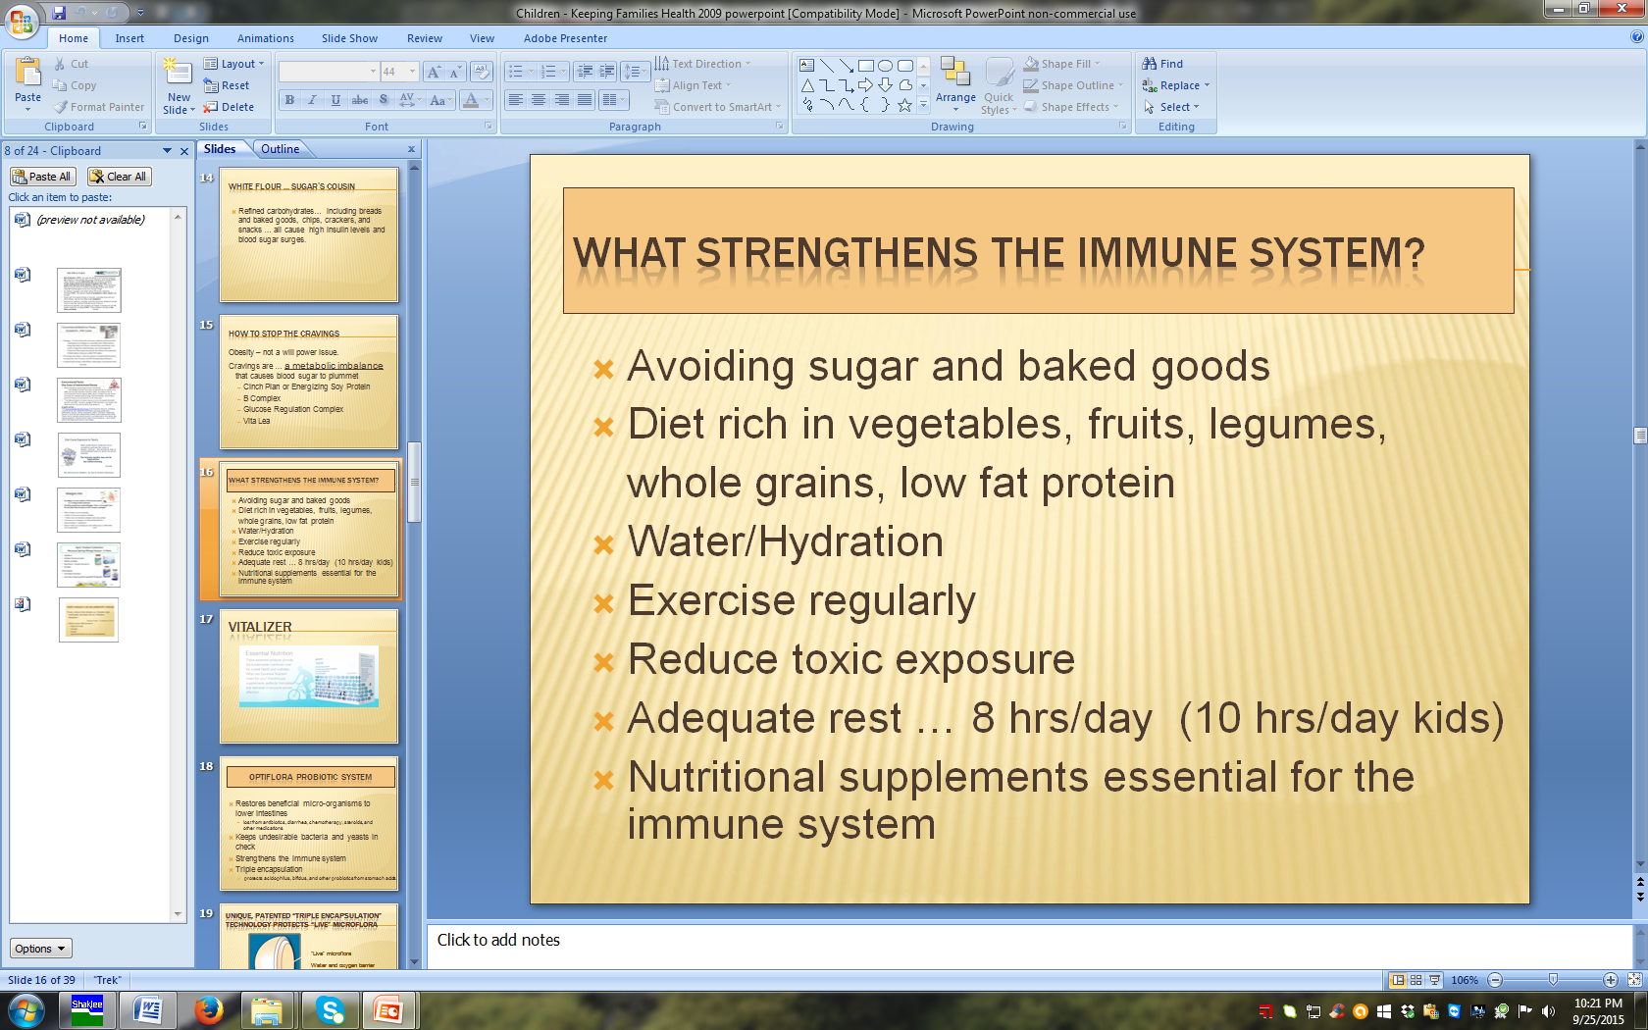

Slide 22
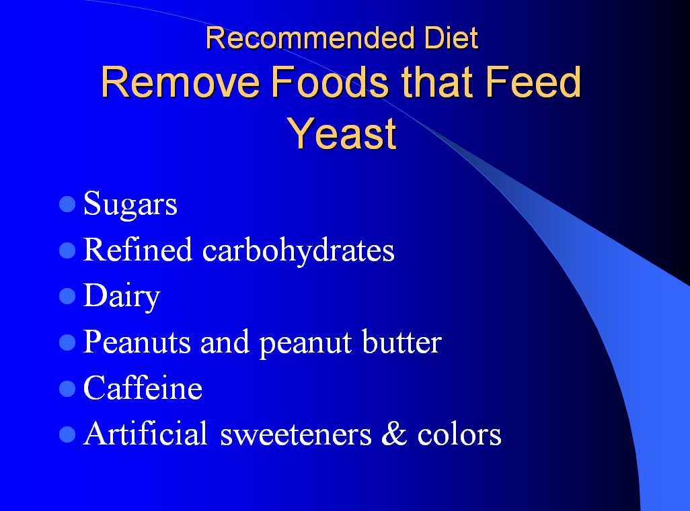

Slide 23
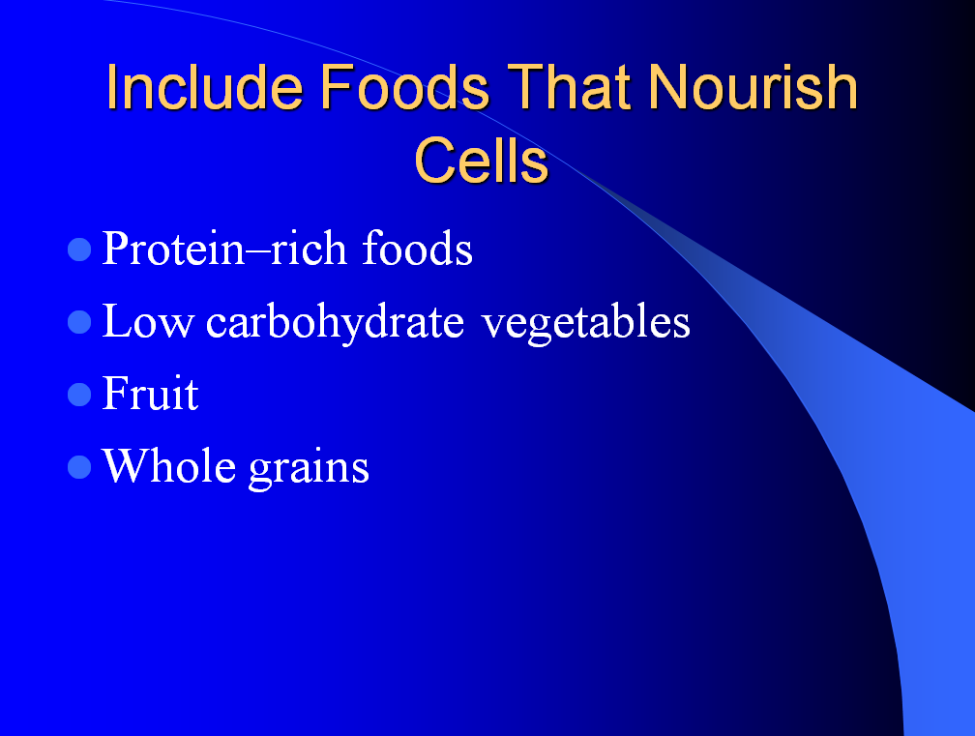

Slide 24
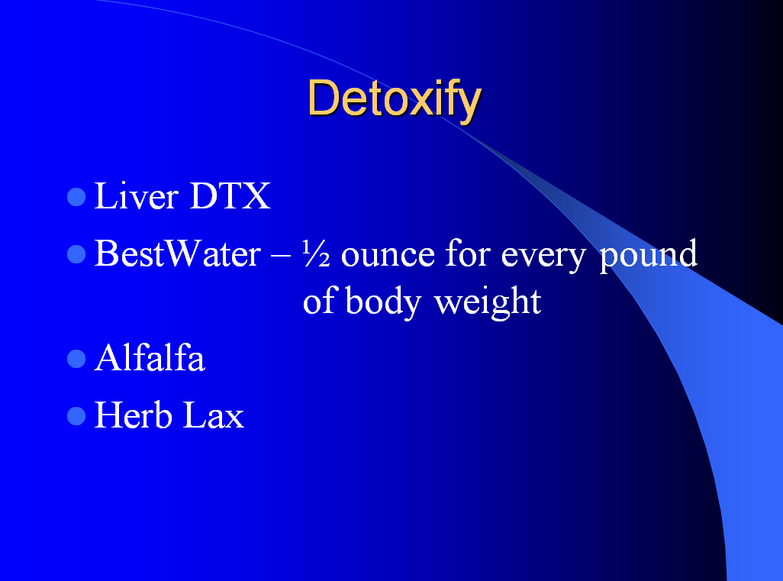

Slide 25
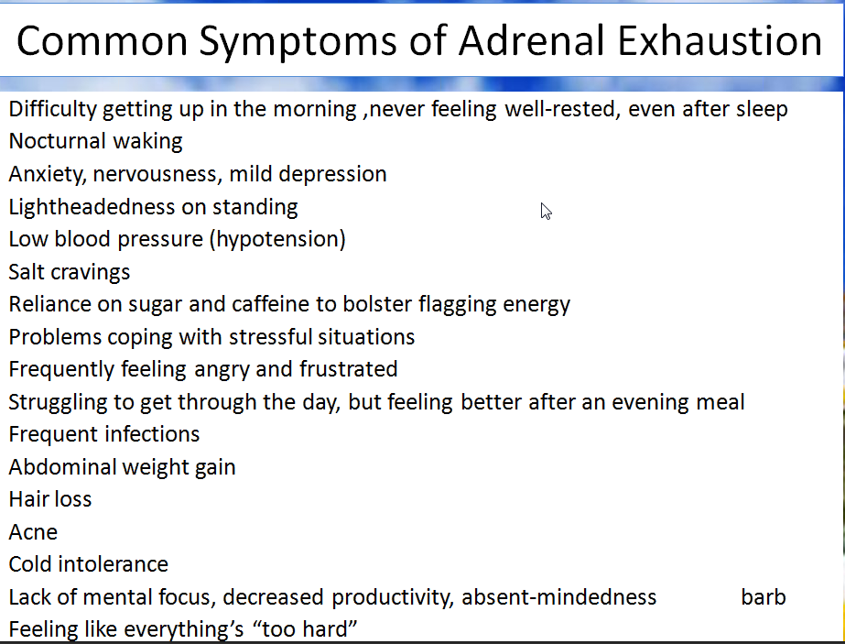

Slide 26
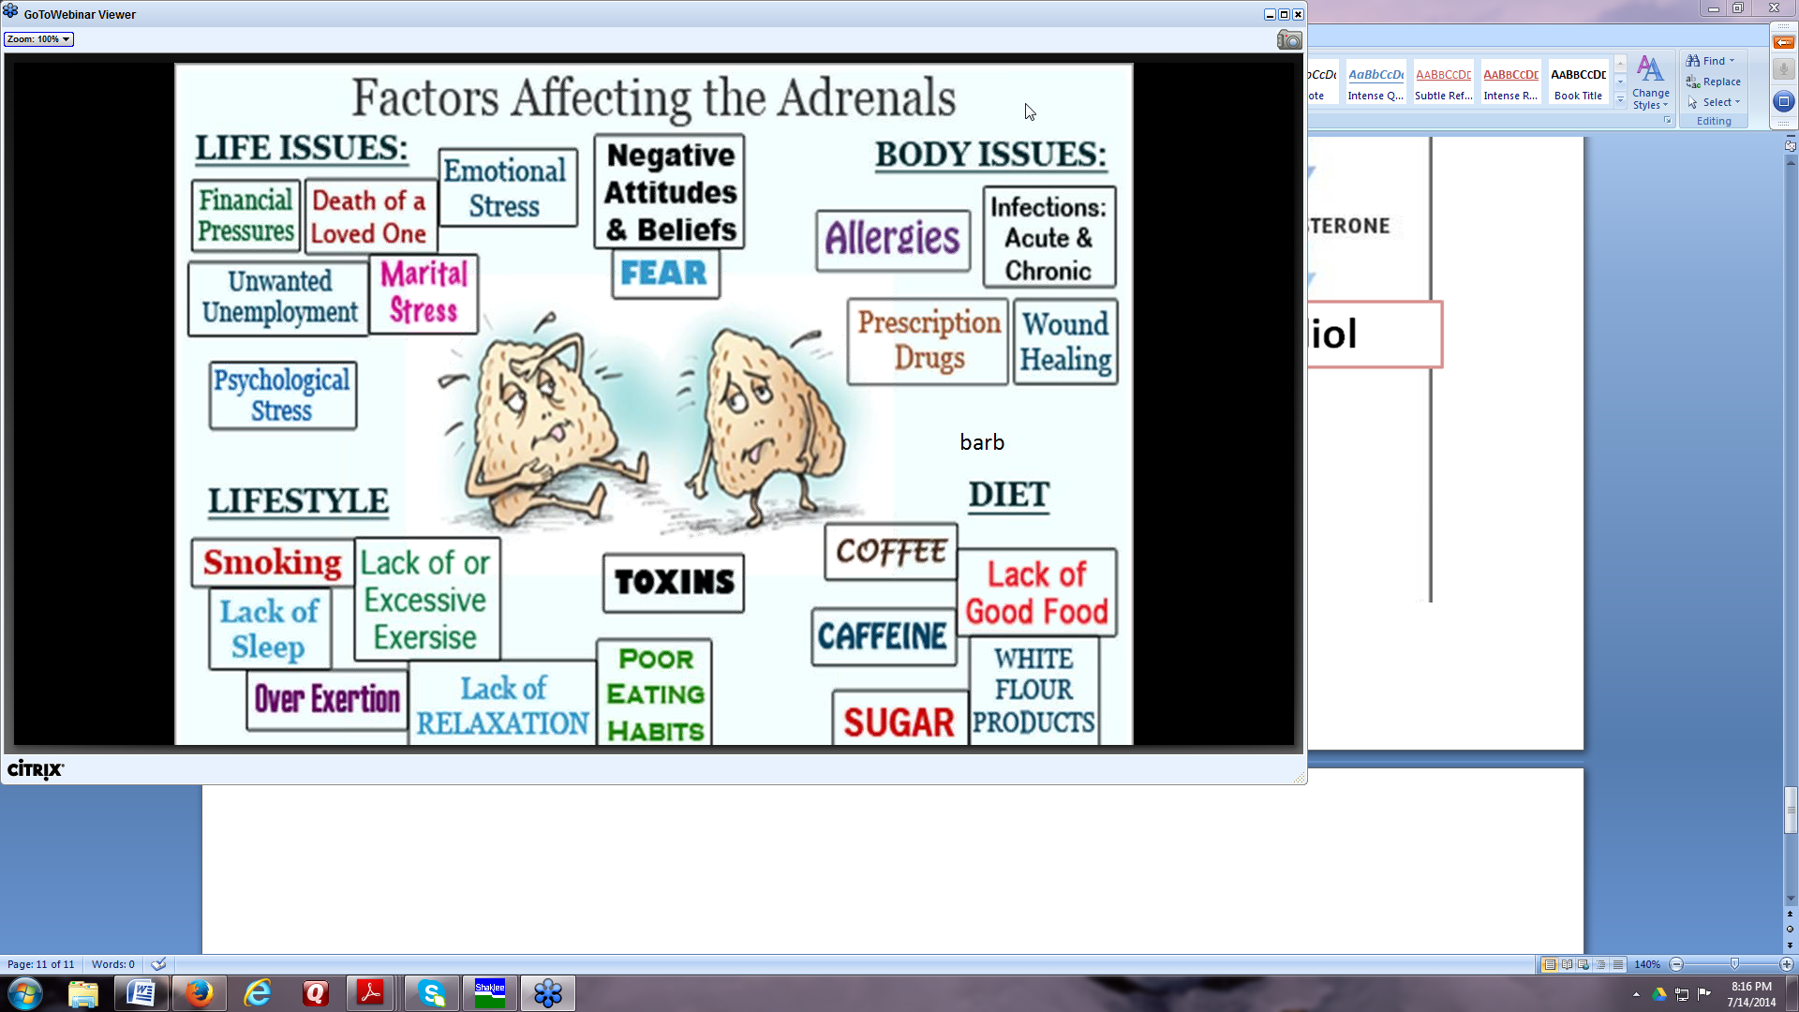

Slide 27
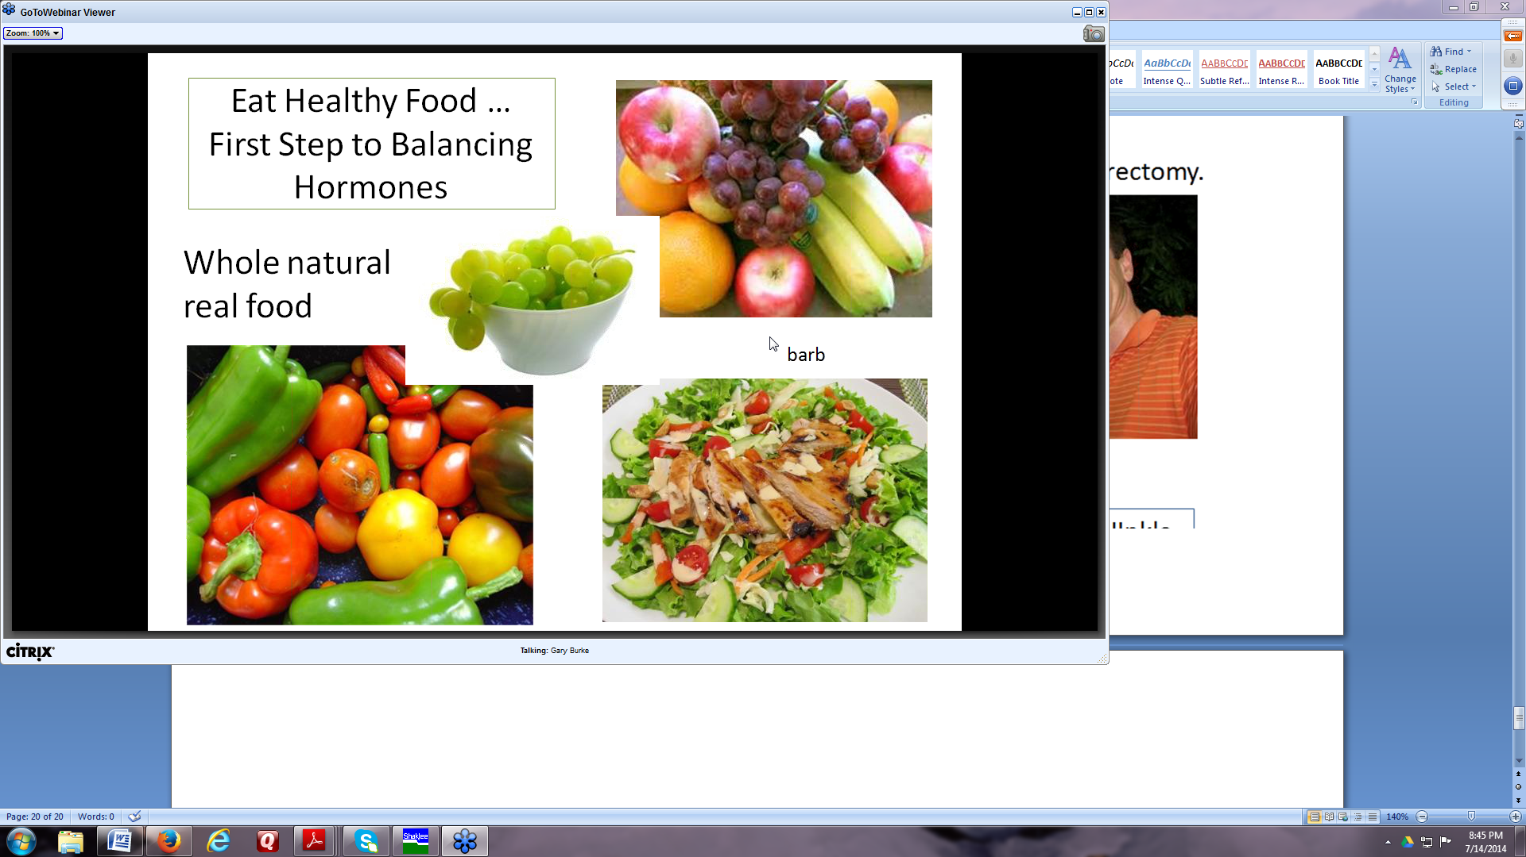

Slide 28
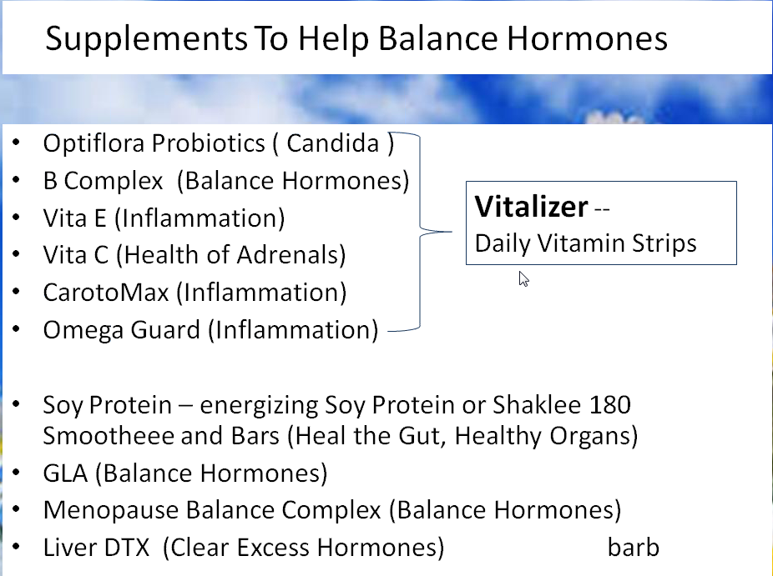

Slide 29
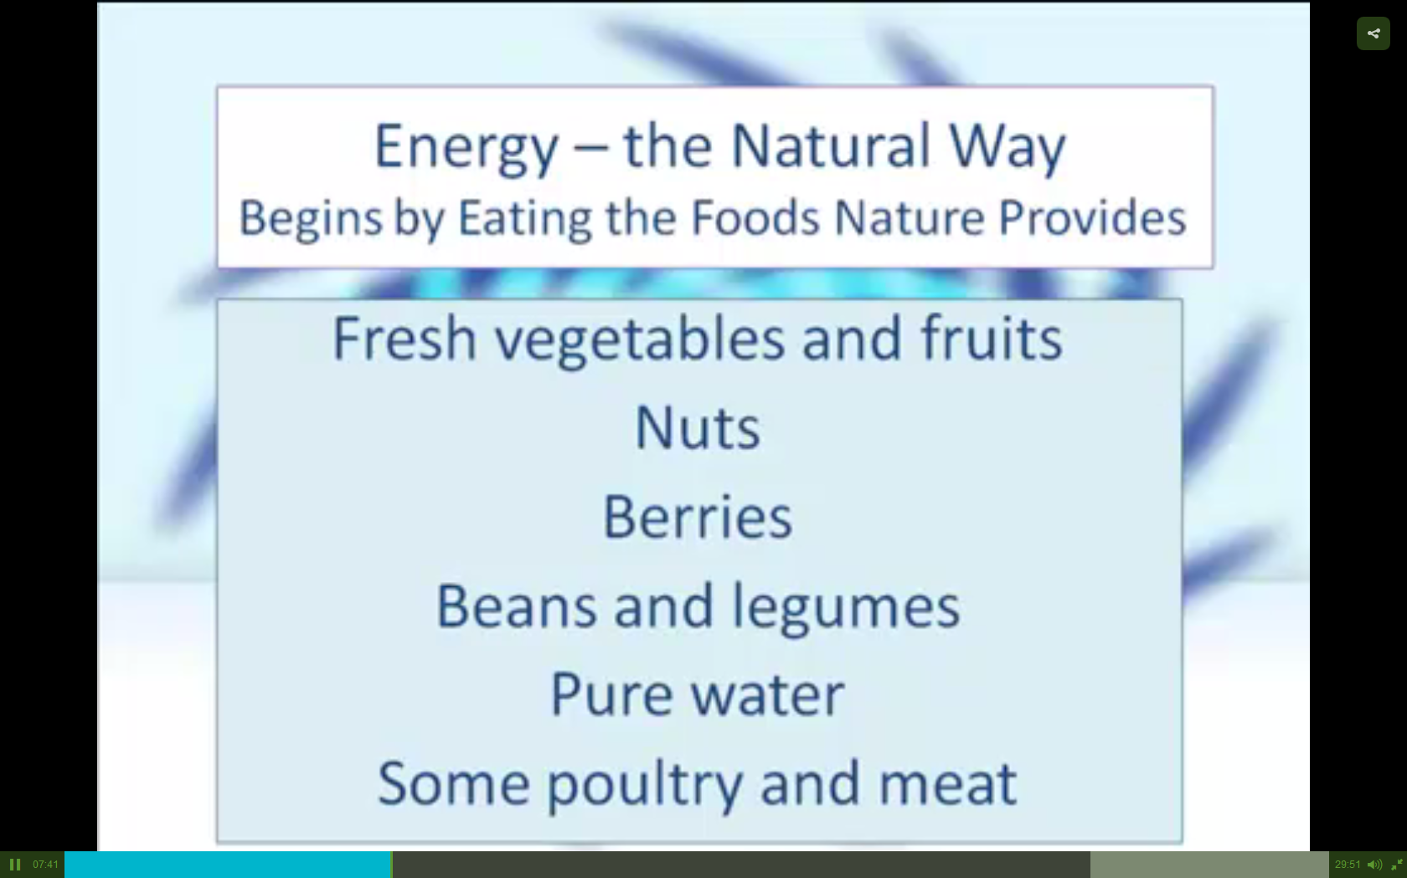

Slide 30
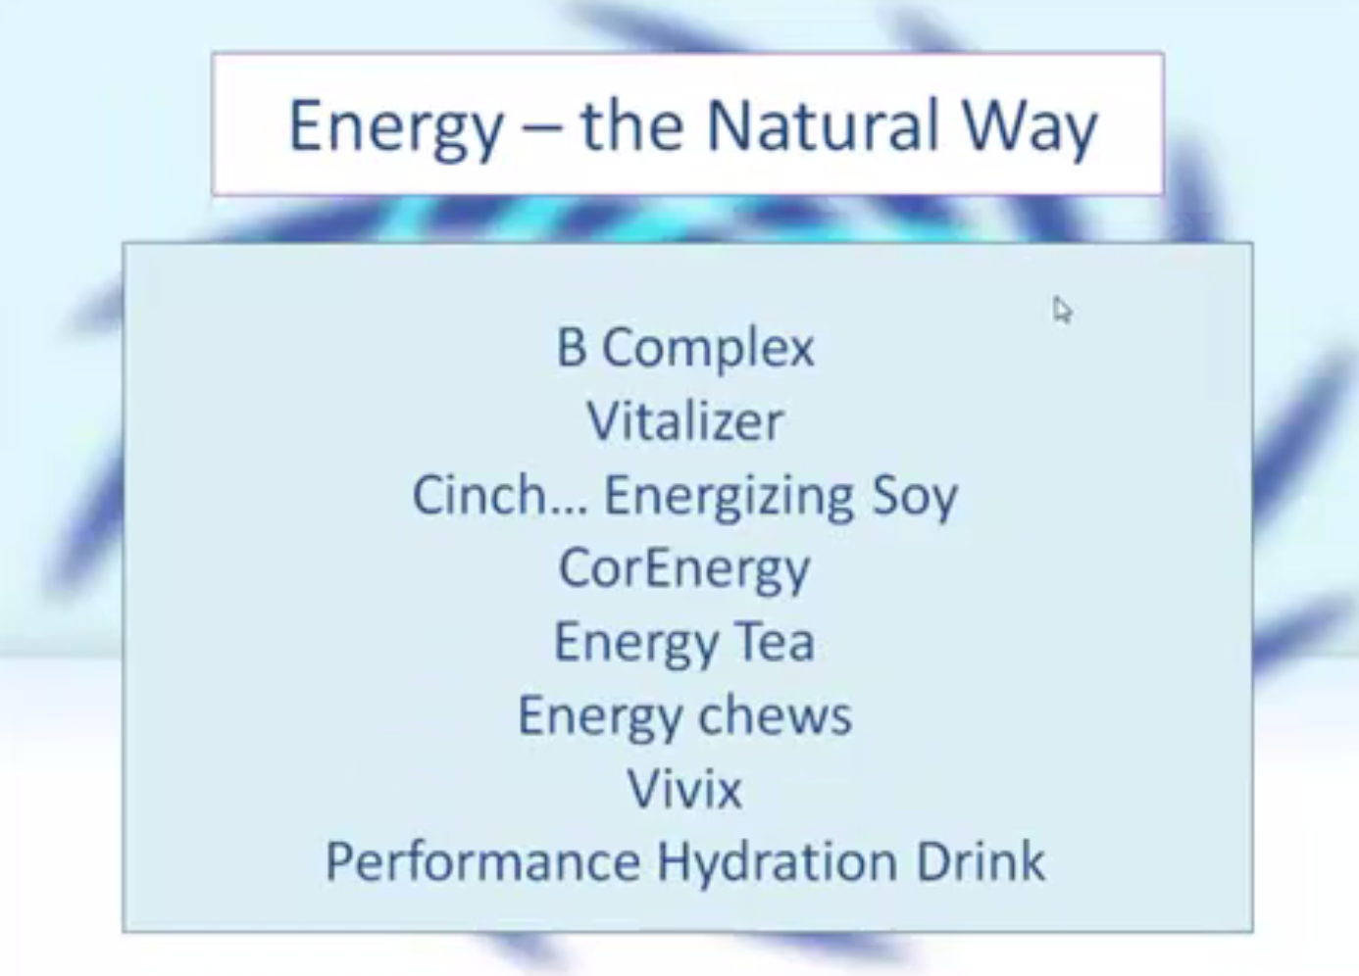

Slide 31
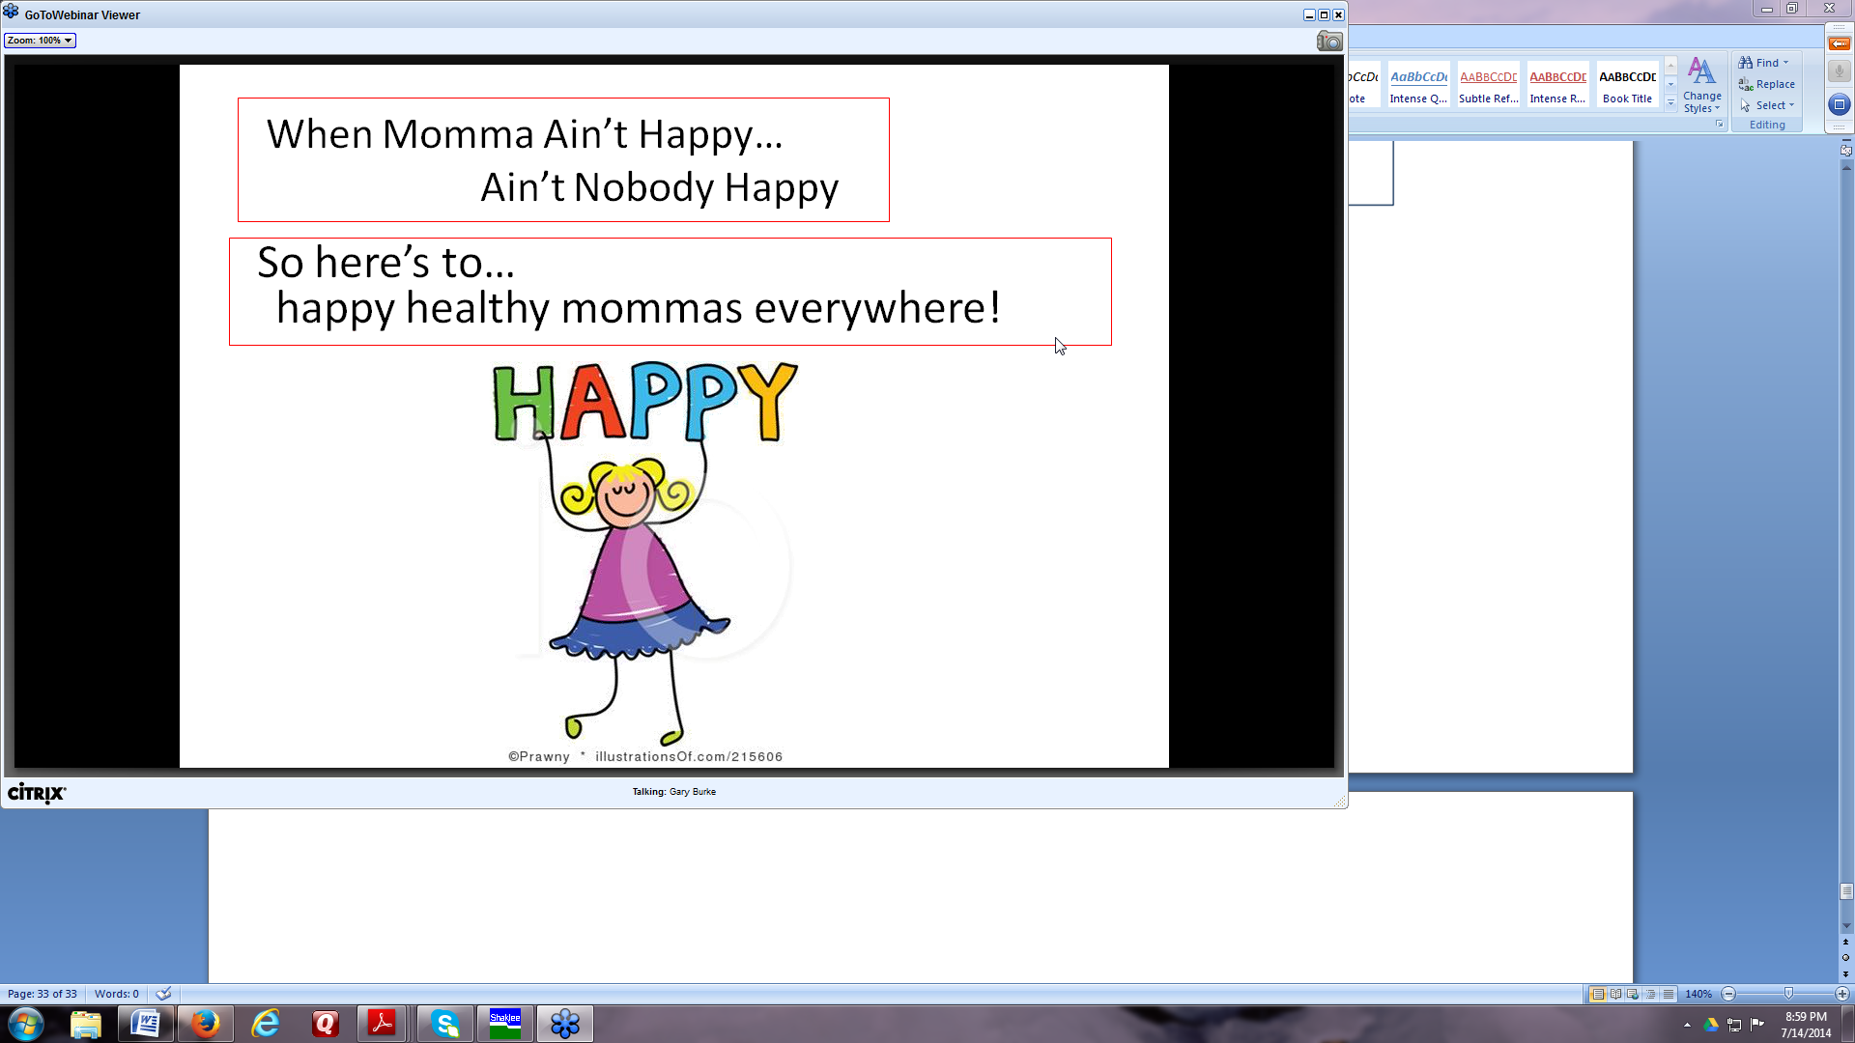

Slide 32
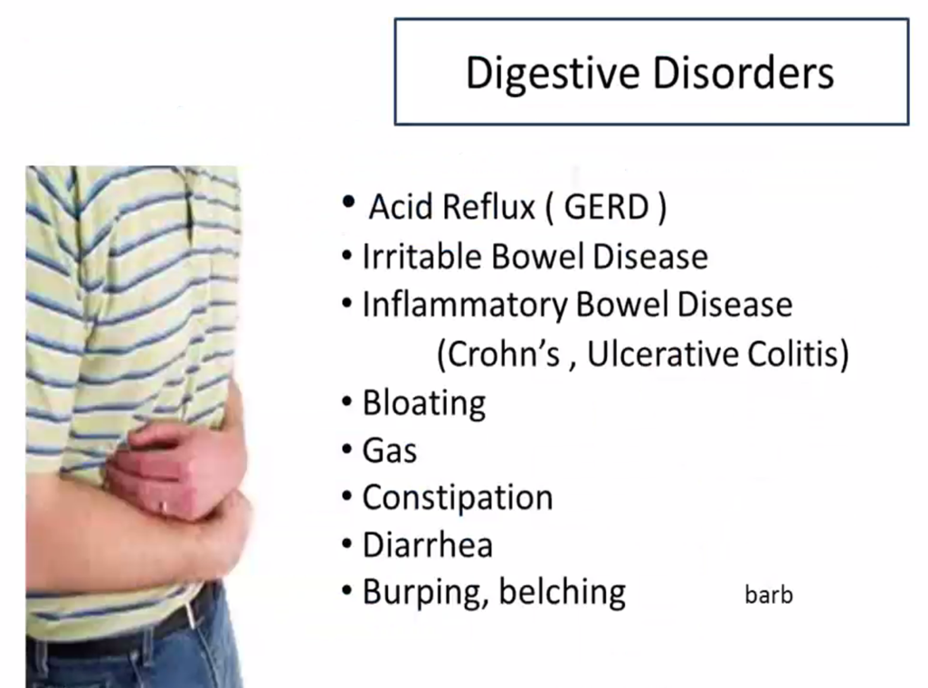

Slide 33
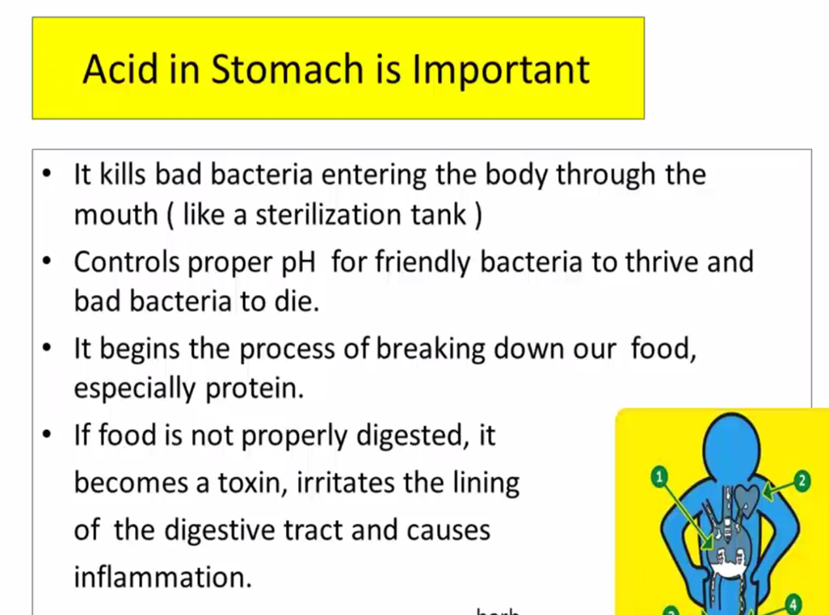

Slide 34
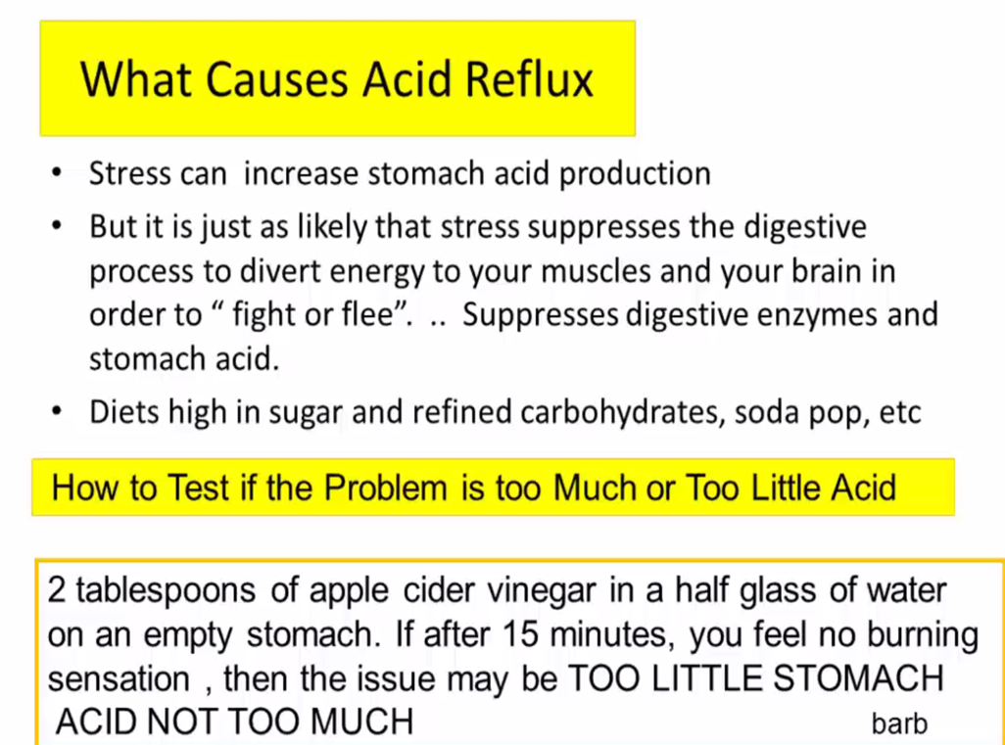

Slide 35
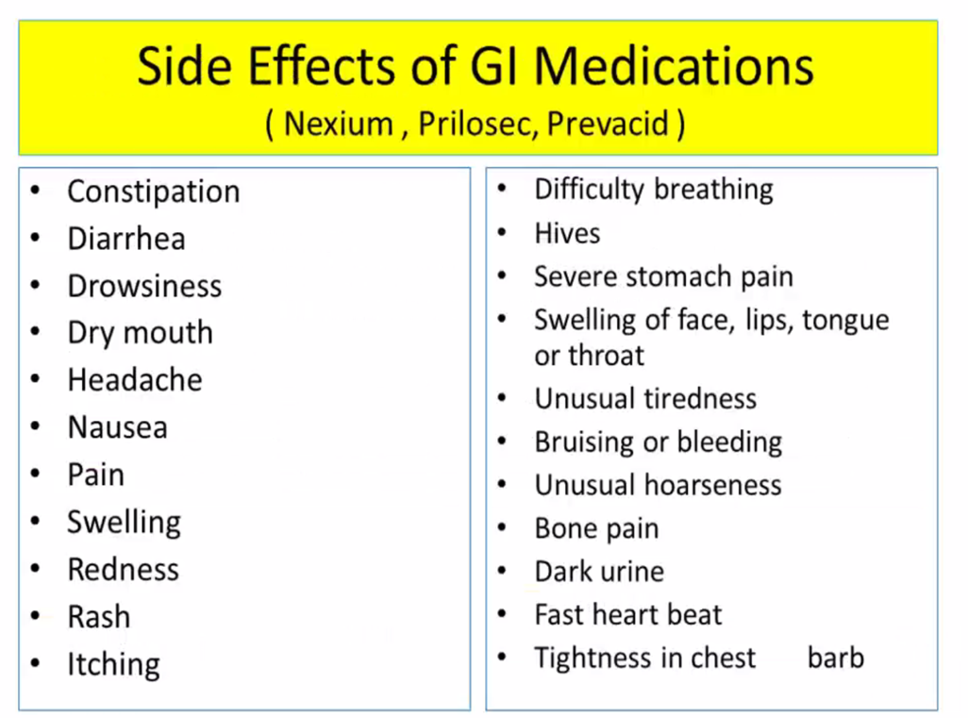

Slide 36
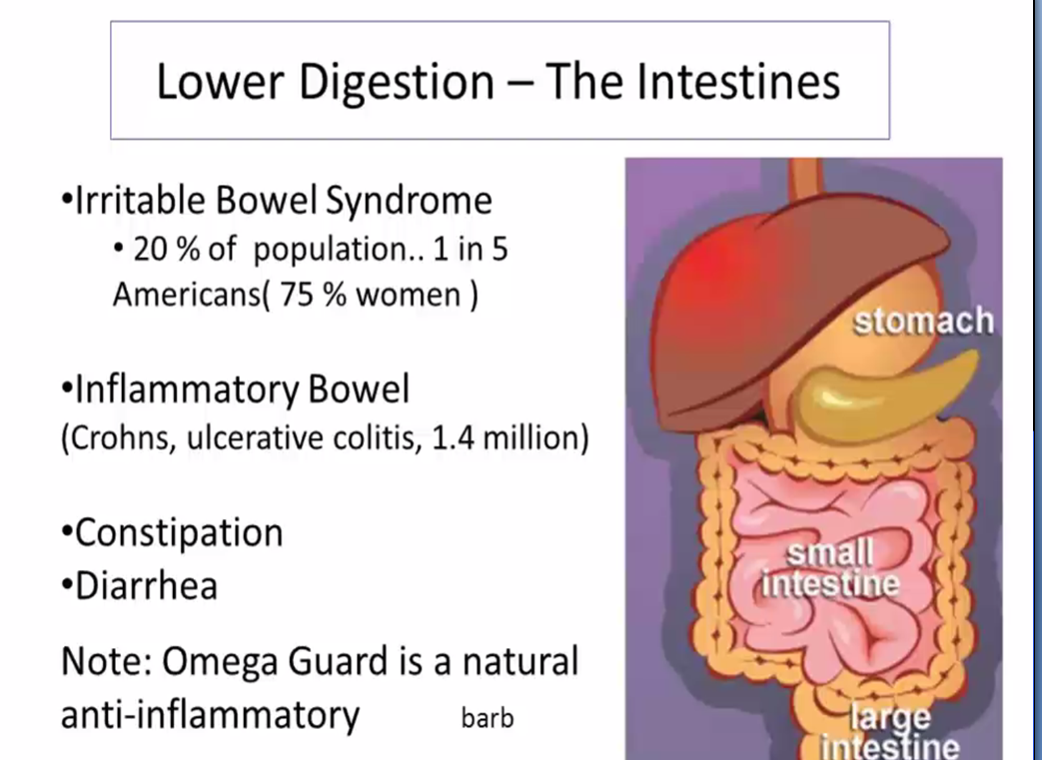

Slide 37
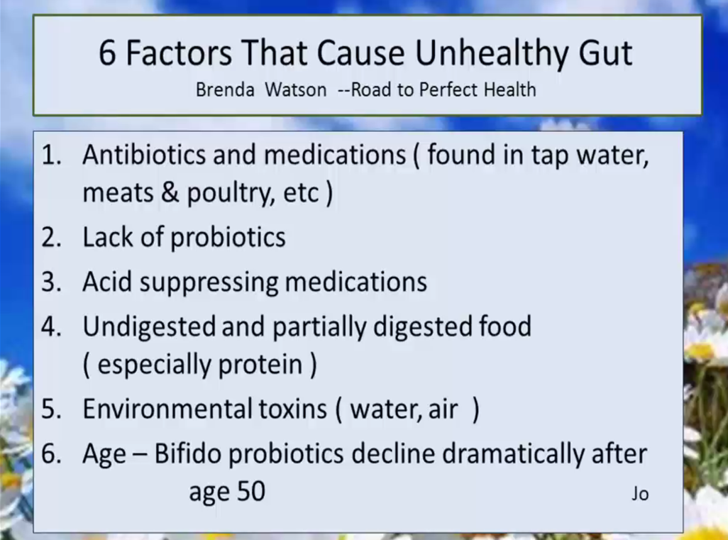

Slide 38
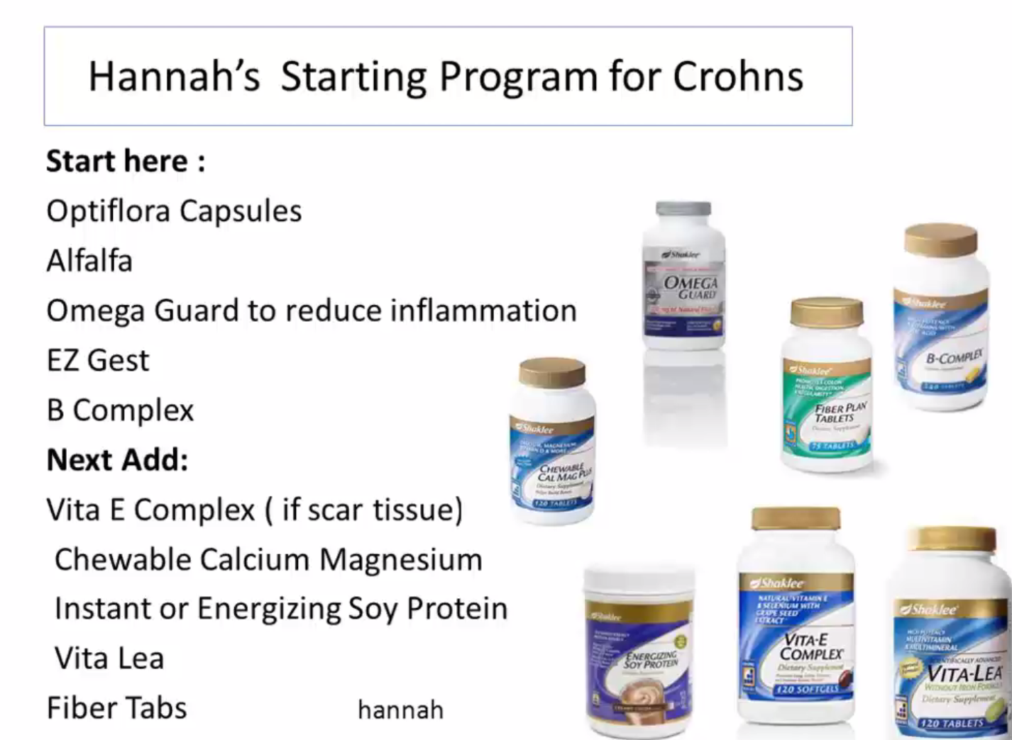

Slide 39
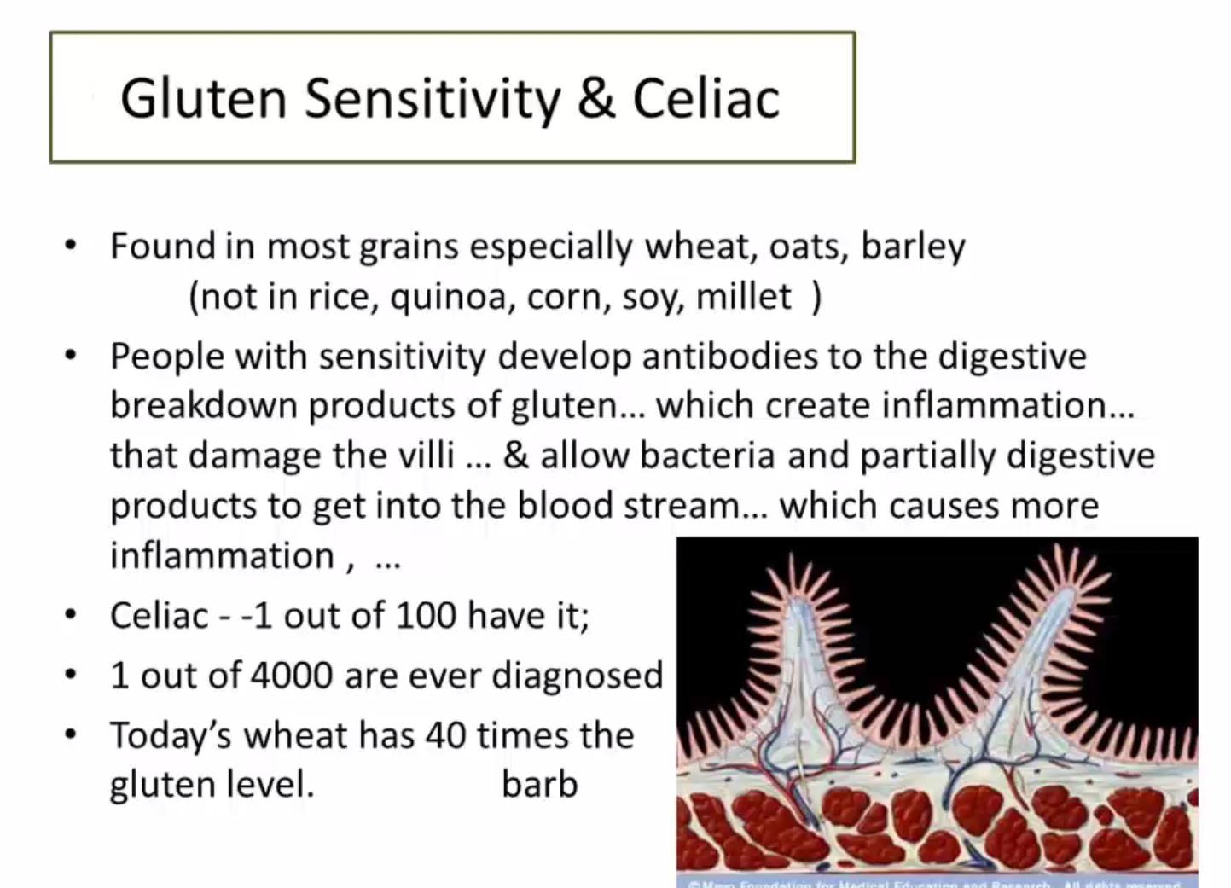

Slide 40
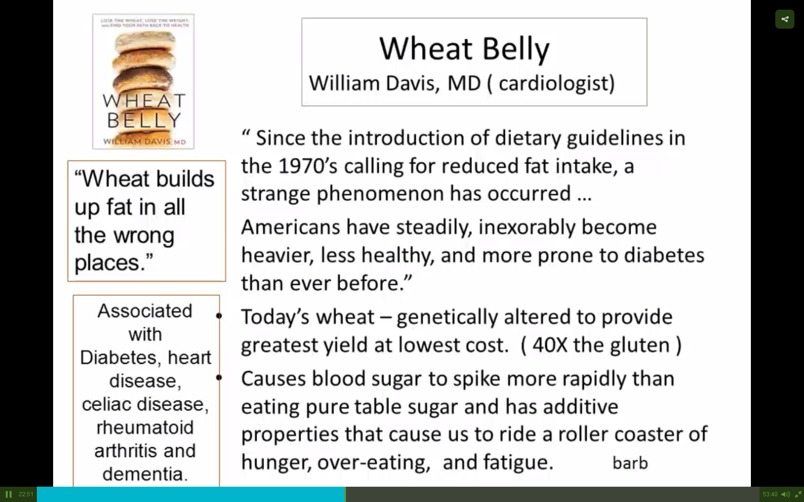

Slide 41


Slide 42
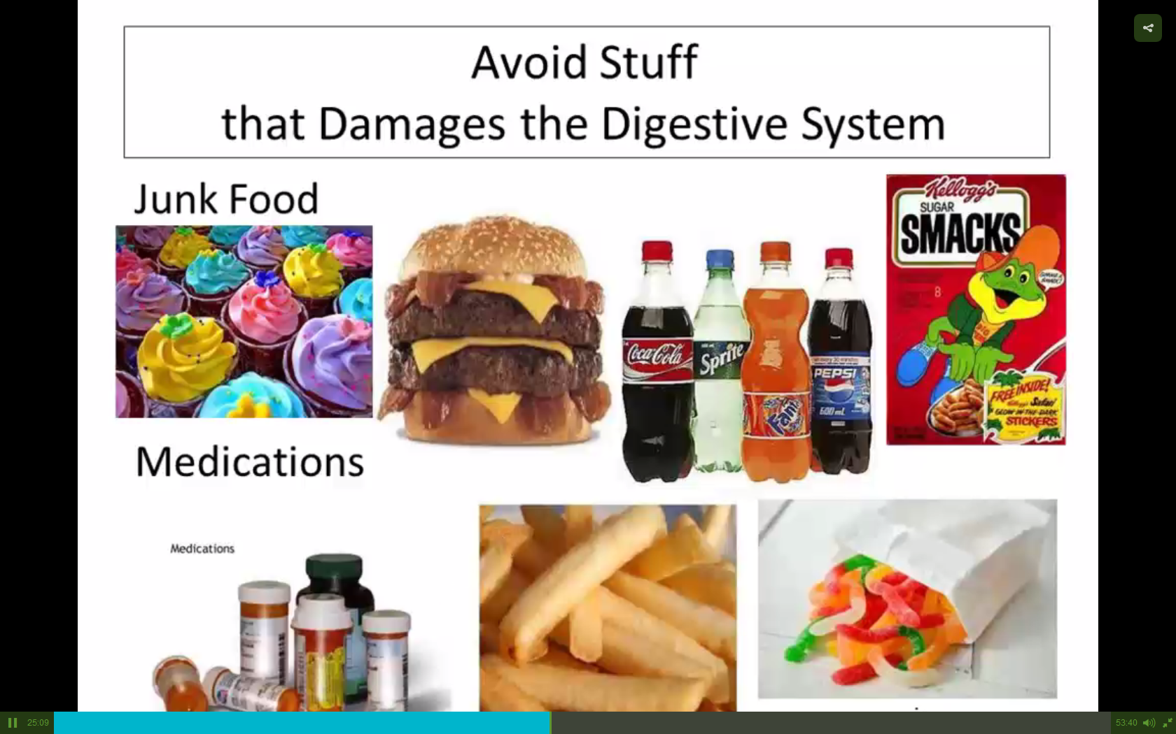

Slide 43
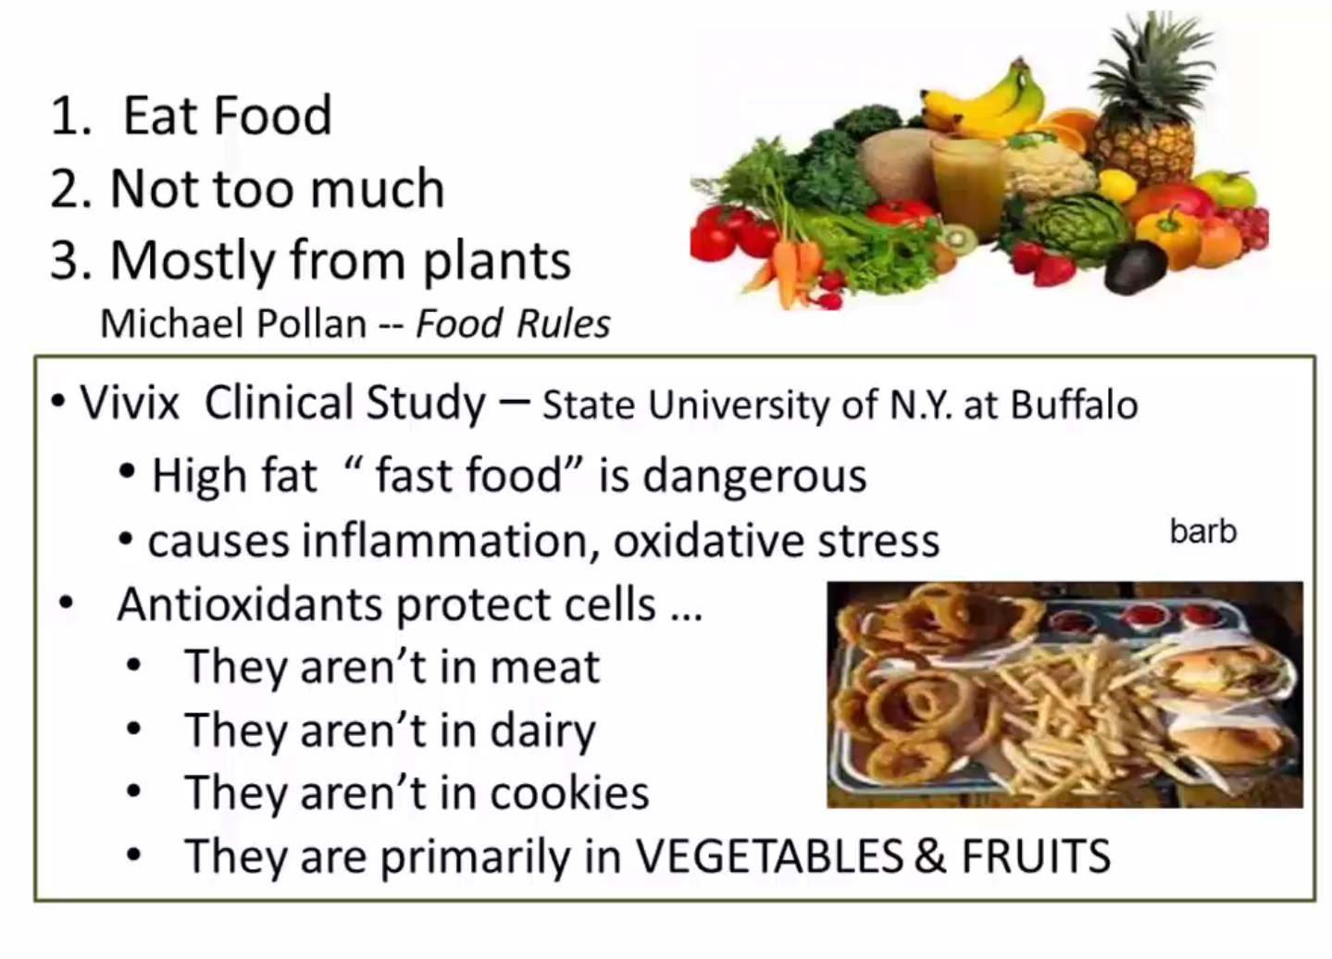

Slide 44
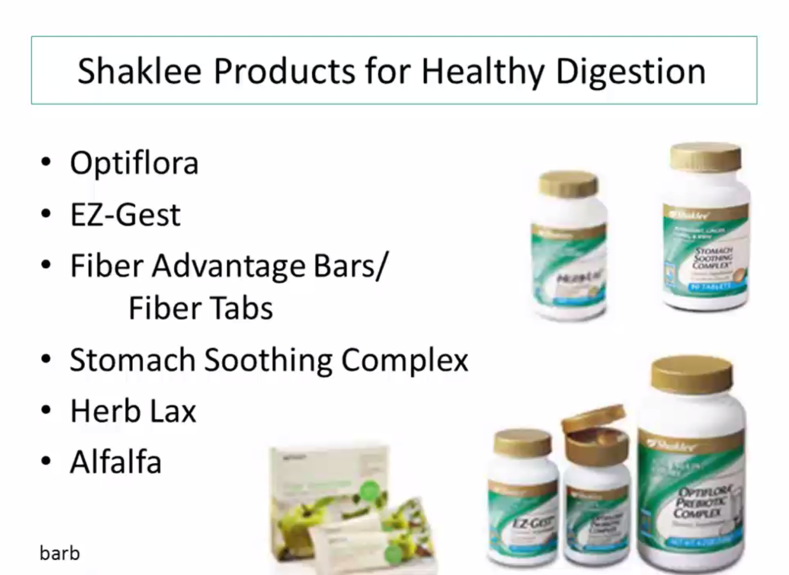

Slide 45
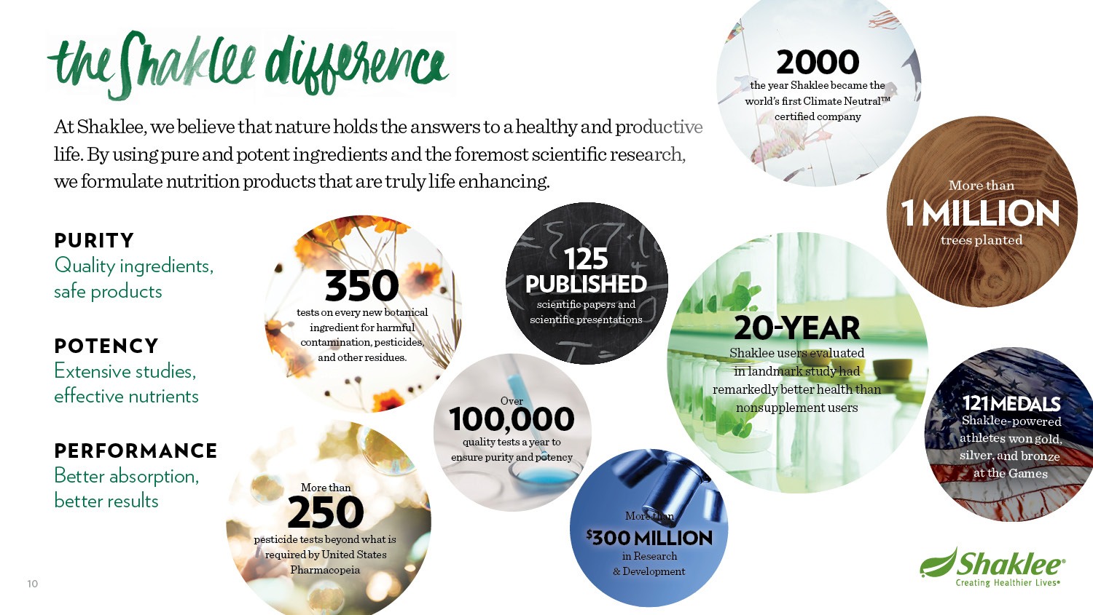

Slide 46
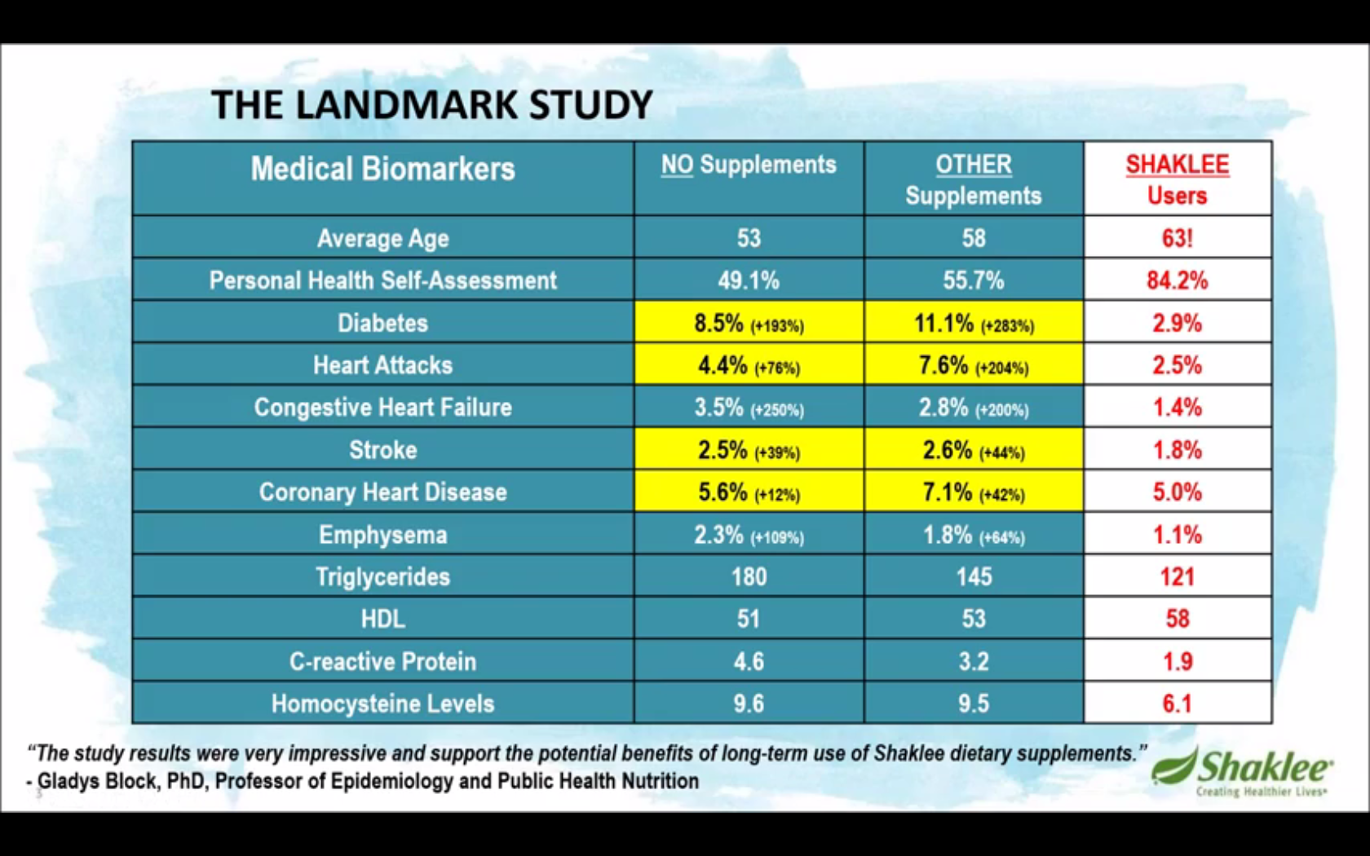

Slide 47


Slide 48
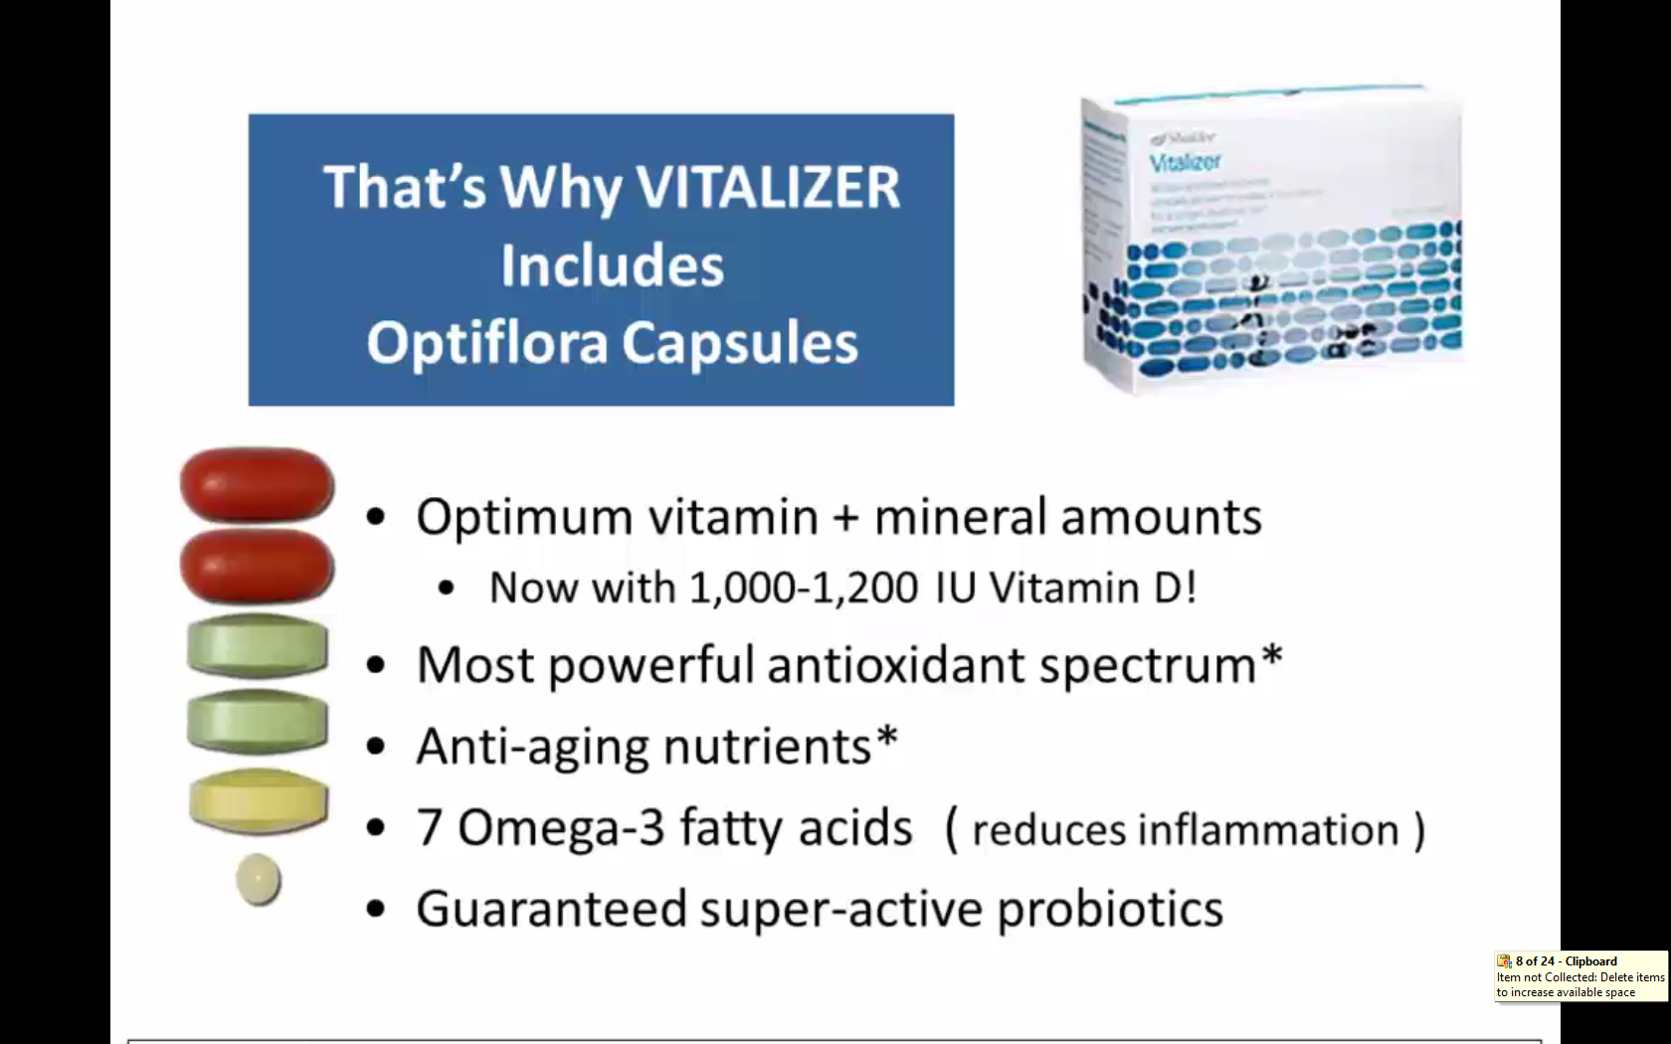

Slide 49
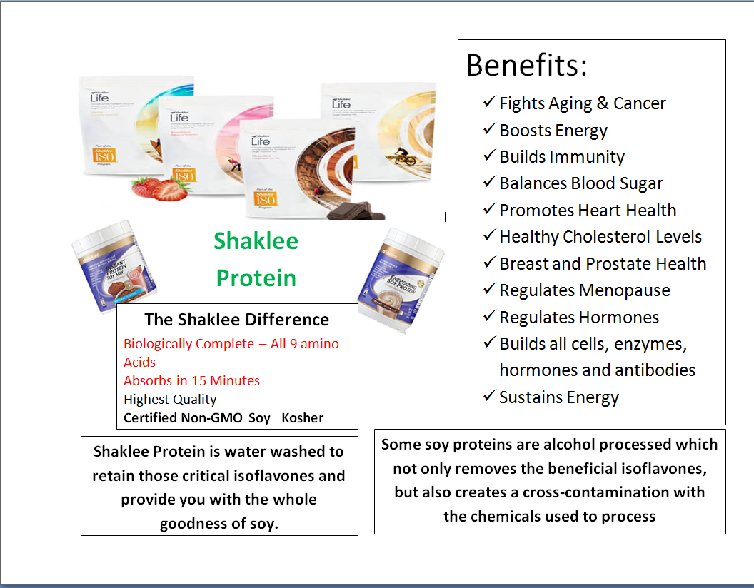
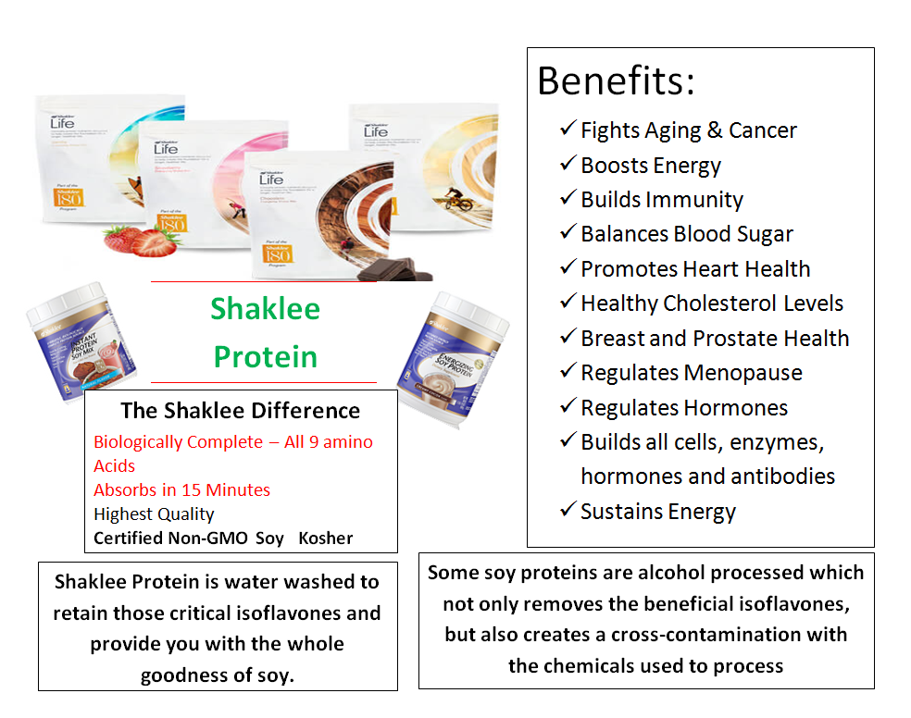
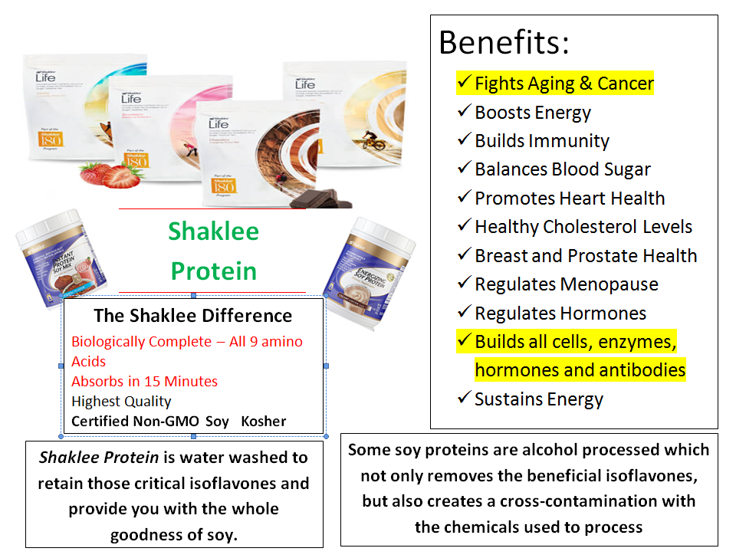
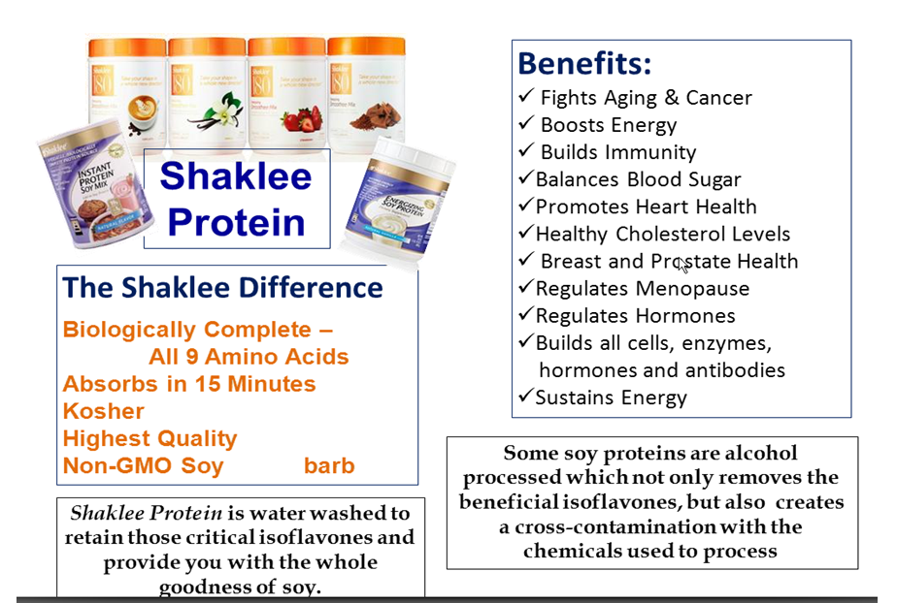

Slide 50
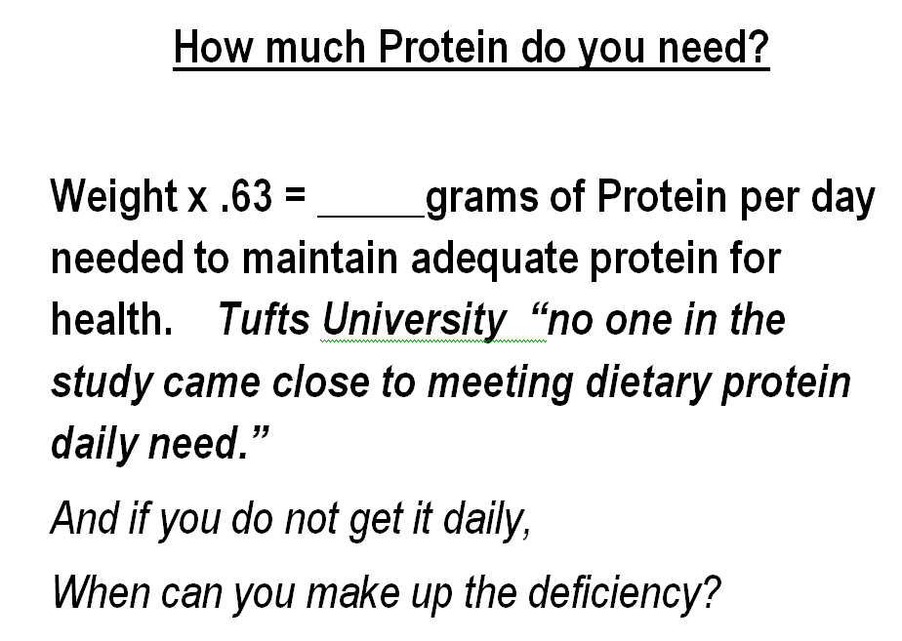

Slide 51
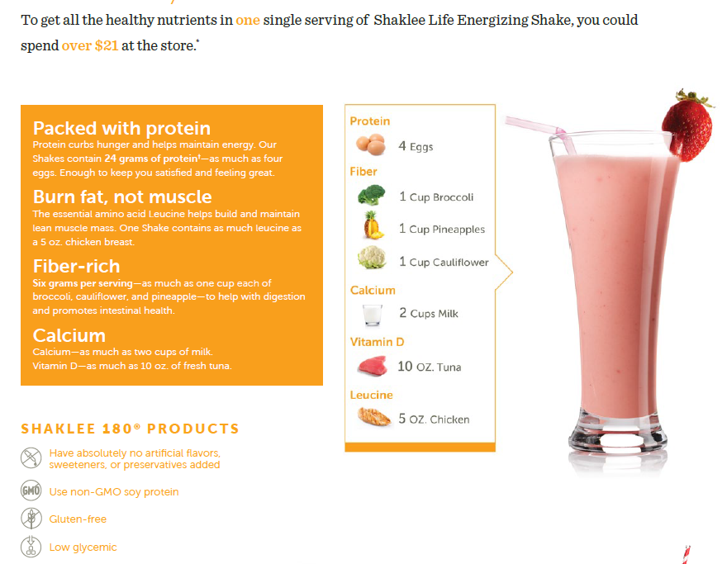

Slide 52


Slide 53


Slide 54


Slide 55


Slide 56


Slide 57


Slide 58


Slide 59


Slide 60


Slide 61


Slide 62


Slide 63


Slide 64


Slide 65


Slide 66


Slide 67


Slide 68
Products Included in the Reset
Products Included in the Reset
Use 2 products…
Vitalizer and Shaklee Life Shakes and lots of vegetables
For Best Results:
Included Life Shake plus Detox Products
(Liver DTX, Alfalfa, Herb-Lax, Energizing Tea and Stress Relief Complex
If a person has major health issues, the Detox may be done too quickly, thus read your body on how it is reacting

Slide 69
Suggested Amounts
Morning
- Optiflora – 1 Tsp prebiotic, 1 Probiotic –1st thing in the morning
- Protein – 1 scoop of Life Smoothee in 8 or more oz of milk/ water –
Can be mixed with fruits and/or vegetables (Life Shake has the Probiotics)
- Alfalfa – 5
-Herb-Lax – 1
Lunch:
- Alfalfa – 5
Mid-Afternoon:
- Protein – 1 scoop of Life Smoothee in 8 or more oz of milk/ water –
Can be mixed with fruits &/or vegetables(The Life Shakes contain Probiotics)
Supper:
- Fiber – 2 tablets
- Alfalfa- 5
Before Bed:
- Herb Lax – 1
- Liver DTX – 3 (Liver cleanses itself between 11:00 p.m & 3:00 a.m.)
** Do the Liver DTX & Optiflora until the bottles are done… then you are finished and don’t need to reorder.
On the 7th day – follow overlap with the REBUILDING program
Lots of water is required while your body is cleansing. Take your weight, divide it by 2, then by 8. This is the number of cups of water your body needs per day.

Slide 70


Slide 71


Slide 72


Slide 73


Slide 74


Slide 75


Slide 76


Slide 77


Slide 78


Slide 79


Slide 80


Slide 81


Slide 82


Slide 83


Slide 84


Slide 85


Slide 86


Slide 87



Slide 88


Slide 89


Slide 90


Slide 91


Slide 92


Slide 93


Slide 94


Slide 95


Slide 96


Slide 97


Slide 98


